Slide 1
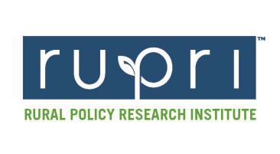

Thinking “Bigger” About Smaller Places: Rural America, the Crossroads, and Rural Cultural Wealth
Presented to the
Creative Counties
Placemaking Challenge Workshop
March 29, 2018
Des Moines, Iowa
Charles W. Fluharty
President & CEO
Rural Policy Research Institute

Slide 2
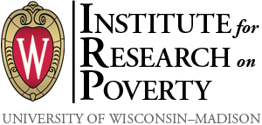



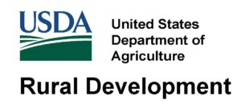




Slide 3
The Framework for Regional Rural Innovation
New
Narratives
& Networks
Quality of
Place
Collaborative
Leadership
Knowledge Networks & Workforce
E-ship & Innovation
Critical Internal Considerations
Wealth Creation, Intergenerational Wealth Retention, and Appropriate Wealth Distribution
Youth Engagement, Retention, and Leadership Development
Social Inclusion and Social Equity Considerations
Specific Attention to Social Mobility and Inequality

Slide 4
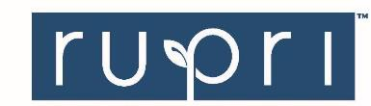
Time to leave GDP behind
Gross domestic product is a misleading measure of national success. Countries should act now to embrace new metrics, urge Robert Costanza and colleagues
1 6 JA N UA RY 2 0 1 4 | VO L 5 0 5 | N AT U R E | 2 8 3

Slide 5
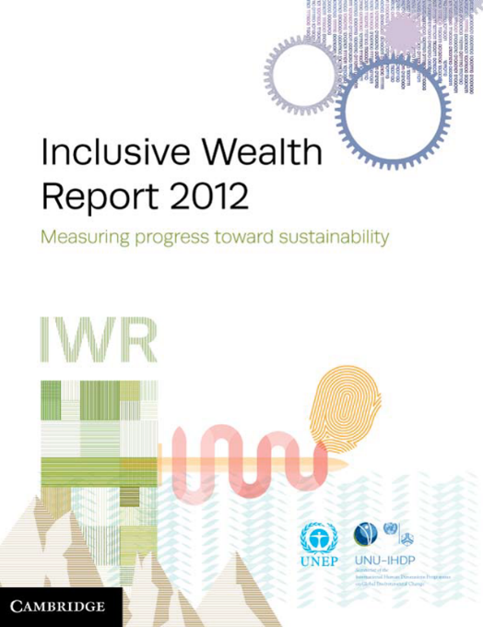


Recent focus on wealth

Slide 6
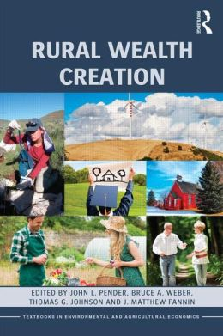
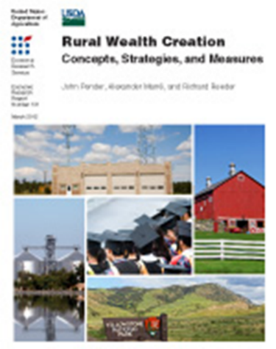
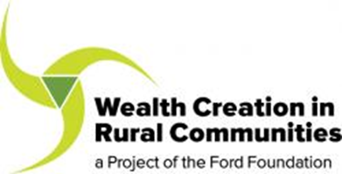
Especially Rural Wealth

Slide 7
Eight Forms of Comprehensive Rural Wealth/Distribution
Physical
Financial
Natural
Human
Intellectual
Social
Cultural
Political

Slide 8
Are We Merely Valuing What We Can Measure, or Measuring What We Truly Value?
Why does this matter?
What can we do about it?

Slide 9


Slide 10
Nothing in all the world is more dangerous than sincere ignorance and conscientious stupidity.
- Martin Luther King Jr.

Slide 11
Characteristics of Comprehensive Wealth
Flows versus stocks (wellbeing versus wealth)
Individual wellbeing is fundamentally a flow measure
GDP is our most common measure of income flow
But well being is dependent on wealth
Wealth is a stock—the net accumulation of assets and liabilities

Slide 12
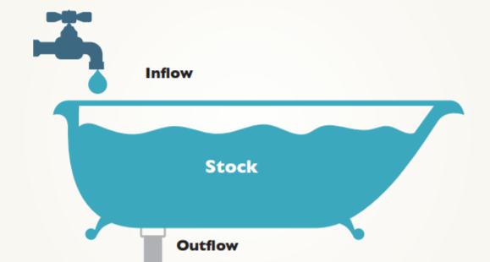

Slide 13

What is Comprehensive Wealth?
Multiple forms of wealth
Investment decisions by individuals and governments
Policy strategies
Comprehensive indicators of outcomes

Slide 14
Policy Implications
A superior basis for assessing economic performance
  Considers benefits and costs of non-market effects
  Considers the returns to investment in the environment, education, health, intellectual property and social capital
Clarifies the concept of sustainability
  Sustainability is growth in comprehensive wealth
Recognizes the complementarity among types of capital
  Environment and health, natural capital and intellectual capital, for example

Slide 15
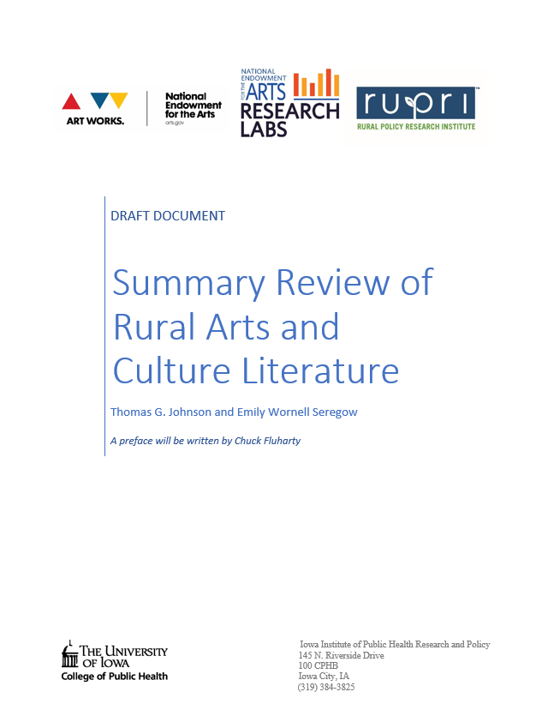

Slide 16
Key Findings
There is a dearth of rural arts and culture research. Most research is urban focused or assumes either there are no rural-urban differences or dismisses rural cultural assets, out of hand.
The research that has been done with a rural lens indicates that rural areas have a unique combination of particularized, place-based assets, often related to natural resources heritage. These must be measured in different ways, to fully account for their contributions to arts, artists and cultural assets, and comprehensive rural cultural wealth.
The best rural arts and culture research has occurred in other nations. Likewise, much of the US urban research, too often based on unproven theories of change, lacks sufficient rigor to drive policy action.
Finally, urban strategies for creative economy development may be counter-productive in rural contexts.

Slide 17
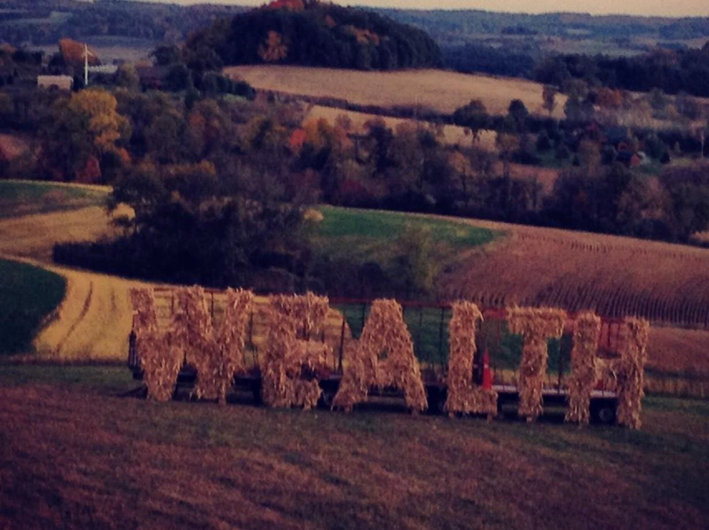

Slide 18
