Slide 1

Building Partnerships In Rural America
Presented to the
Rural Policy Forum
May 17, 2018
Arizona
Teresa Kittridge
Vice President
Rural Policy Research Institute
Founder 100 Rural Women

Slide 2
Presentation Today
The work of RUPRI and how that is utilized practically with communities
Collaborative work with Art of the Rural (AOTR) – addressing the importance and critical need of arts and culture to rural regions and communities
Collective impact investing and what it can do as an economic support system for rural communities

Slide 3
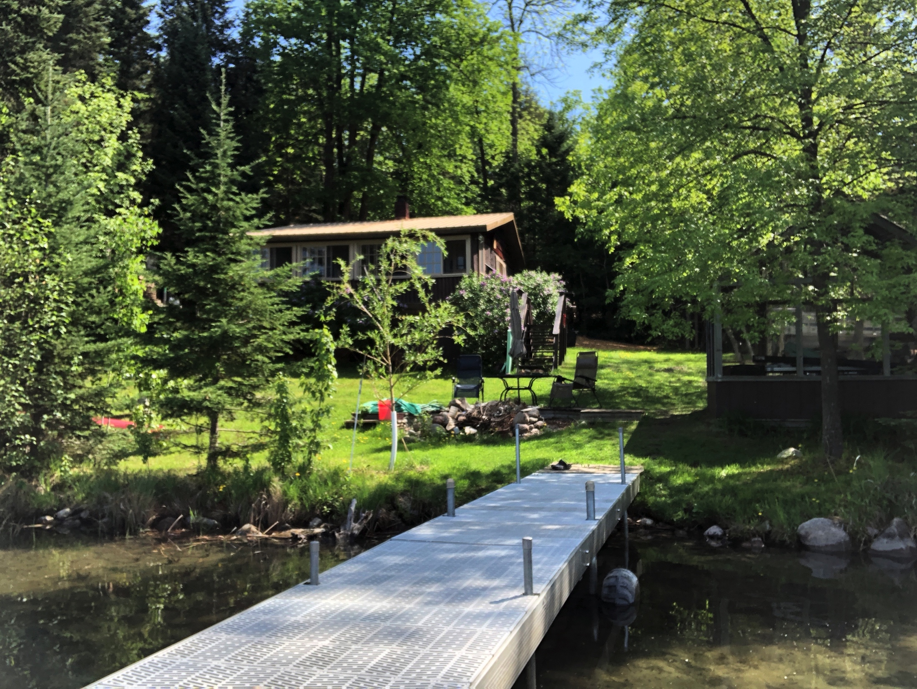

Slide 4
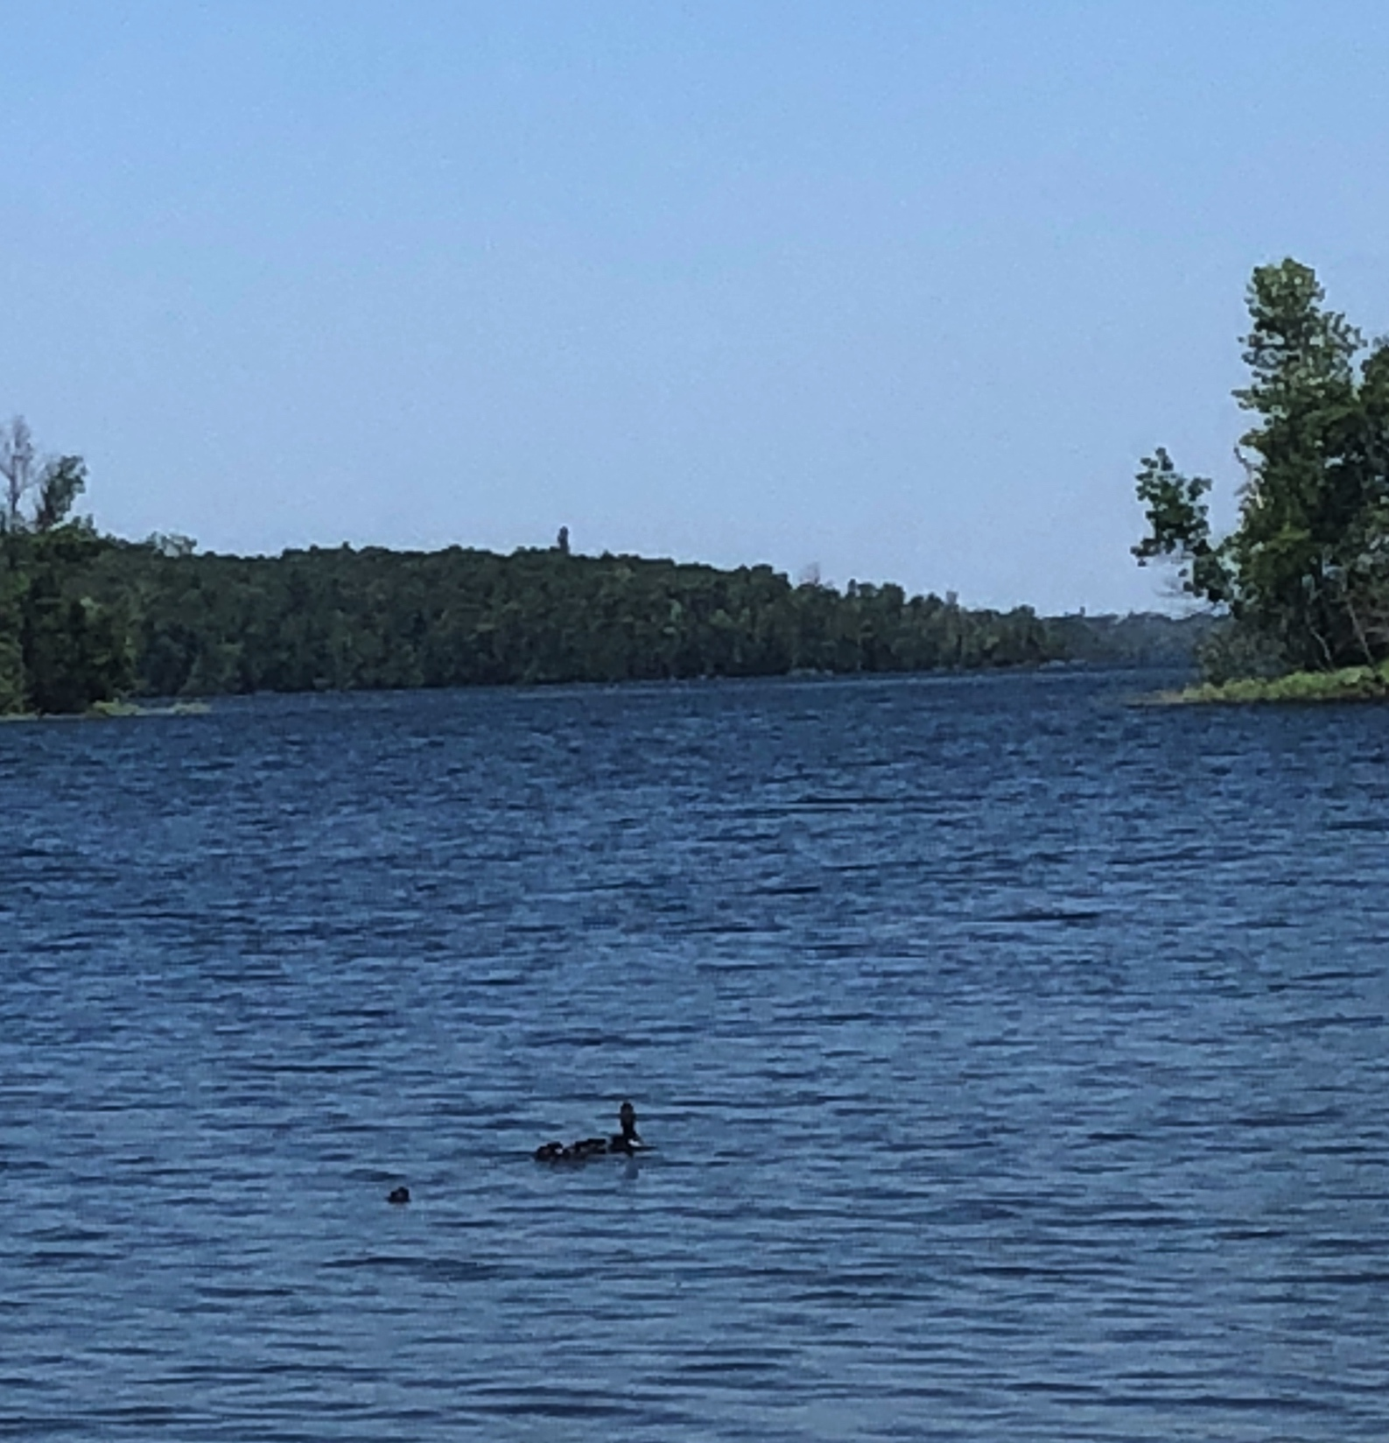

Slide 5
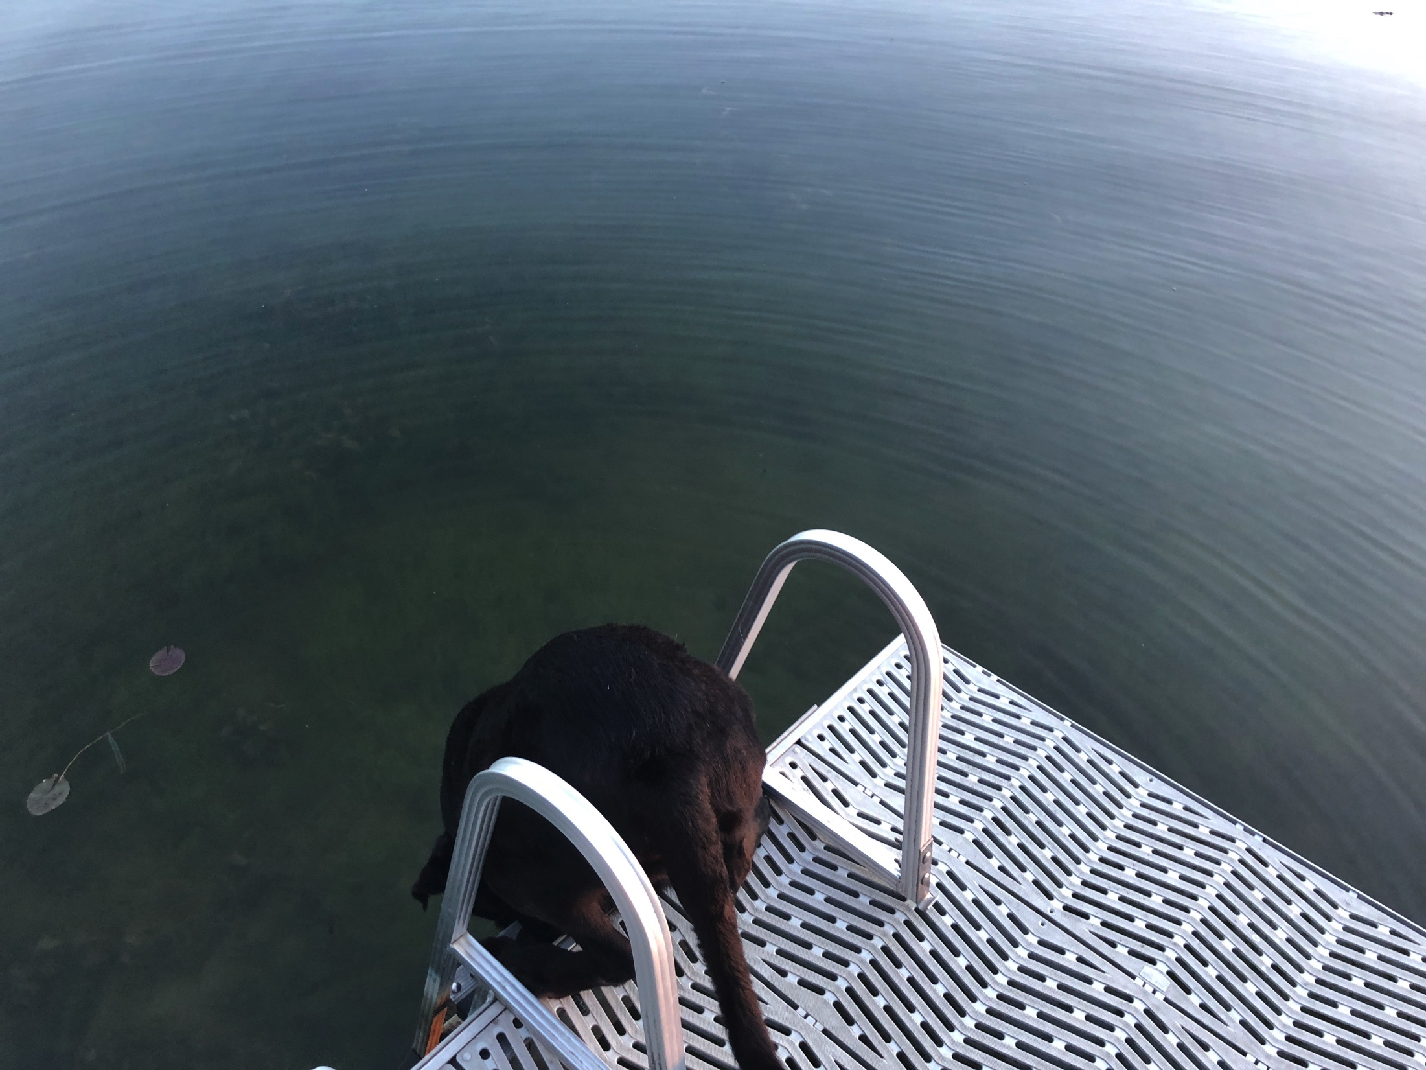

Slide 6
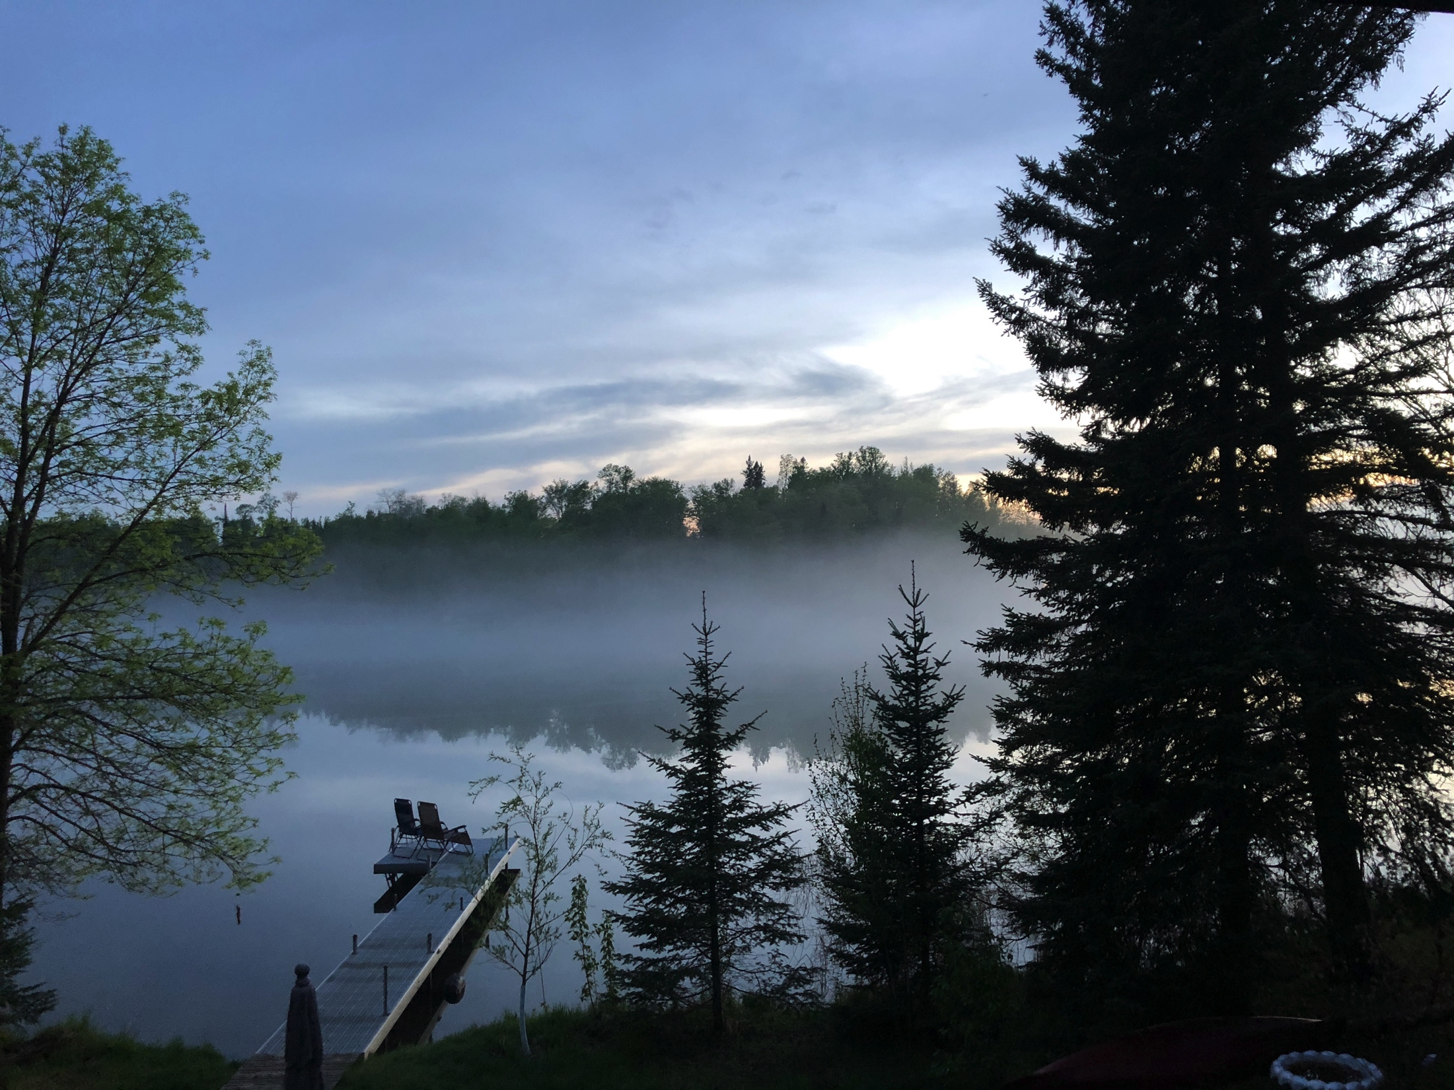

Slide 7
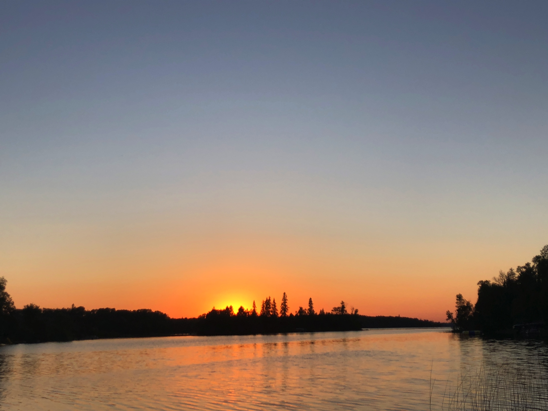

Slide 8
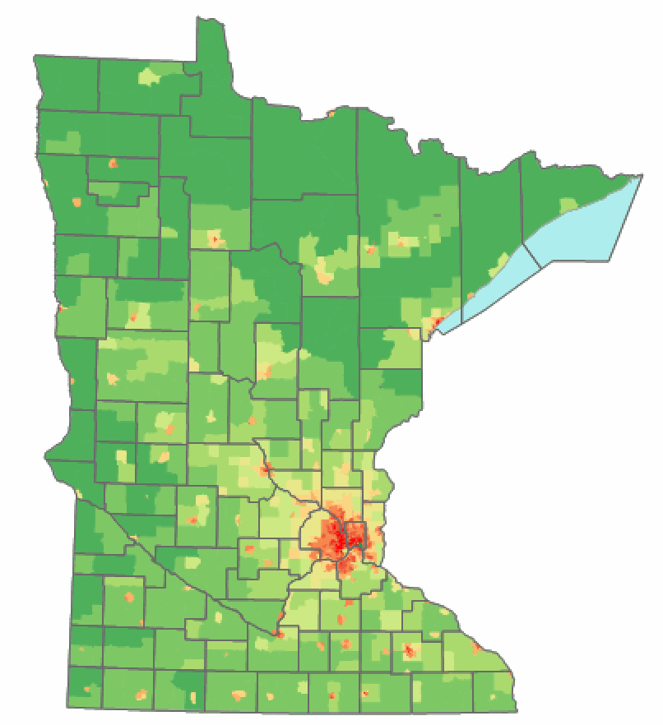
THE NEW GEOGRAPHY OF MINNESOTA
EMPTY LAND
RANGE
Vacation-Land
THE COLONIES
SPRAWL LAND
ETHANOL LAND

Slide 9
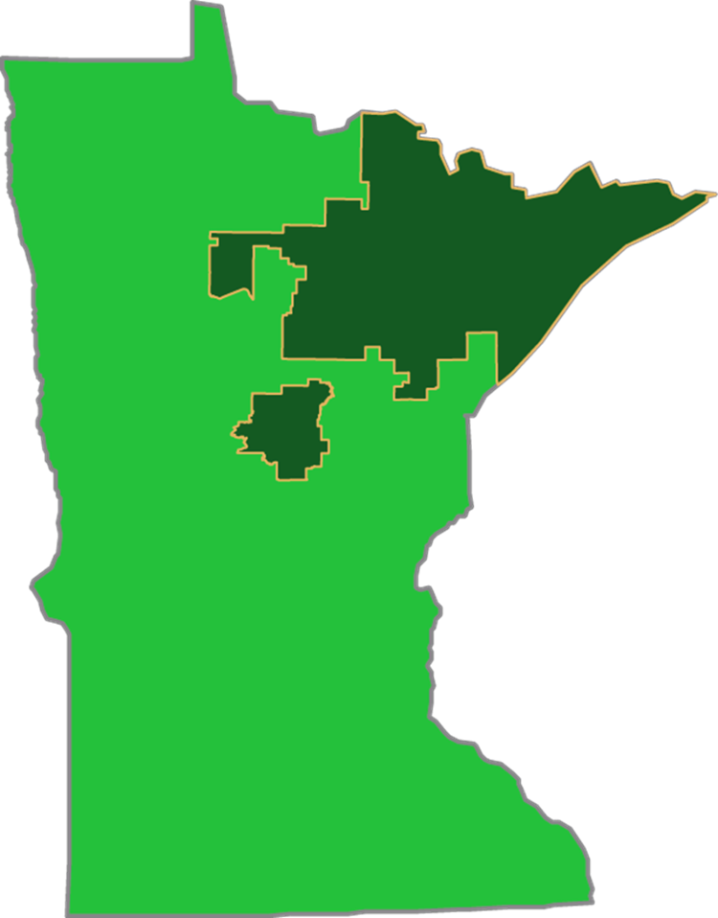

Slide 10
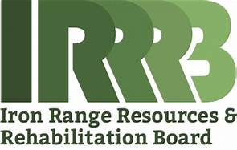
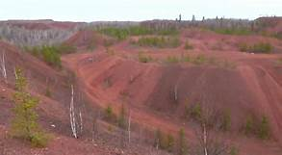
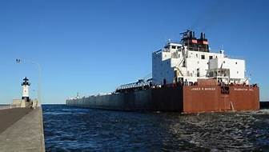

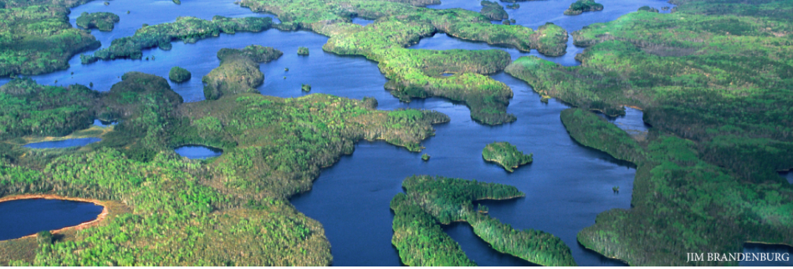
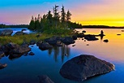
Notes:
1941 establishes a trust fund
Iron ore – taconite
New – sulfide concerns watershed copper nickel
Laurentian divide
Tourism – mining. Forestry. Public lands.
Pipelines – tars ands to great lakes for shipping
New inititve in arts and culture

Slide 11
About RUPRI
The Rural Policy Research Institute (RUPRI) is a national policy shop that works cross-sector and provides unbiased analysis and information on the challenges, needs, and opportunities facing rural America. RUPRI’s aim is to spur public dialog and help policymakers understand the rural impacts of public policies and programs.

Slide 12
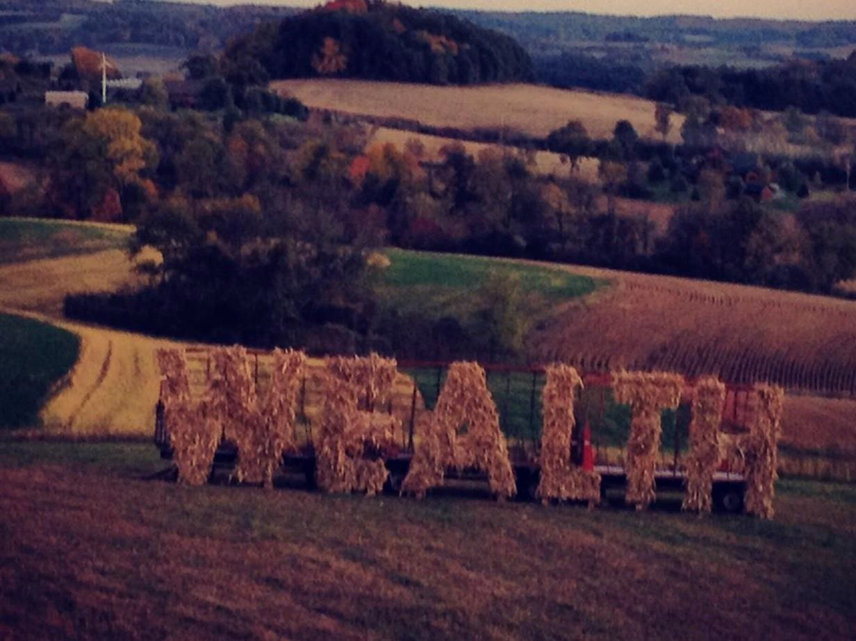

Slide 13
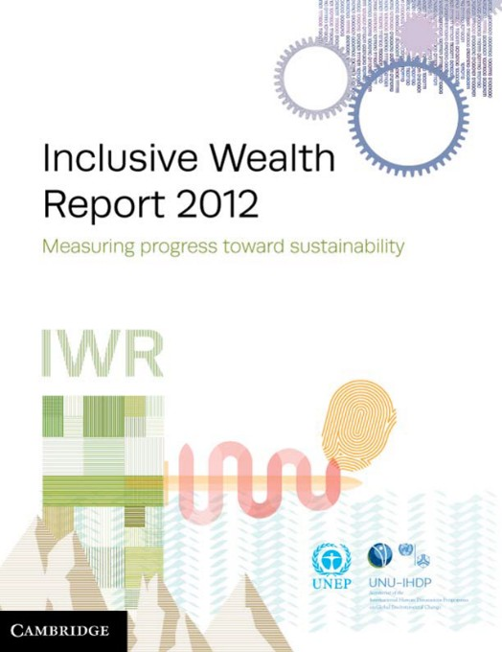



Recent focus on wealth

Slide 14
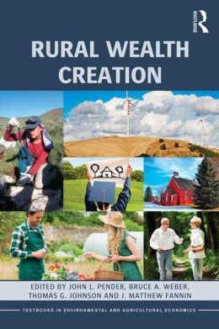
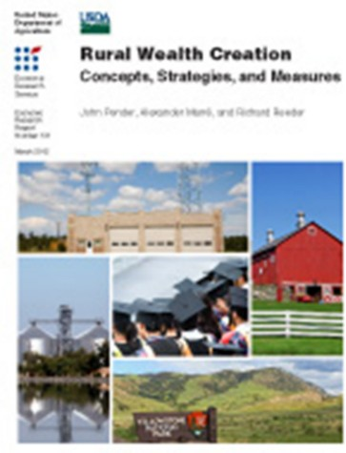
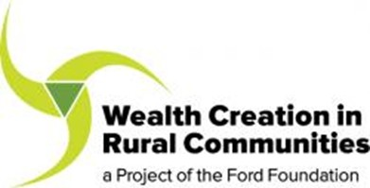
Especially Rural Wealth

Slide 15
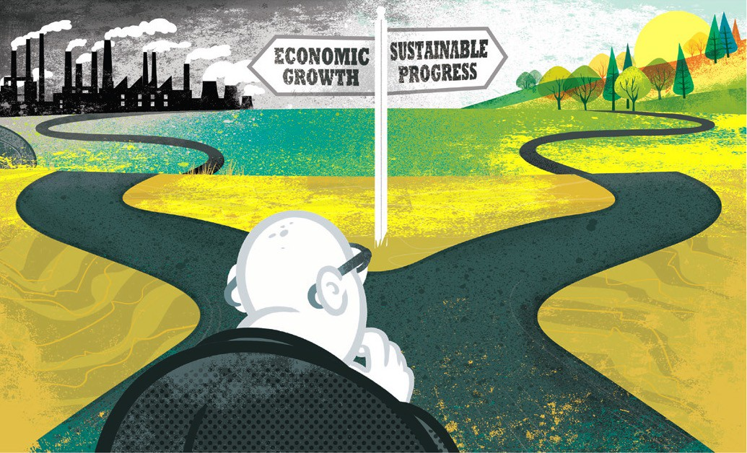
Time to leave GDP behind
Gross domestic product is a misleading measure of national success. Countries should act now to embrace new metrics, urge Robert Costanza and colleagues
1 6 JA N UA RY 2 0 1 4 | VO L 5 0 5 | N AT U R E | 2 8 3

Slide 16


What is Comprehensive Wealth?
Multiple forms of wealth
Investment decisions by individuals and governments
Policy strategies
Comprehensive indicators of outcomes

Slide 17
Are We Valuing What We Measure, or Measuring What We Value?
Why this matters and what we can do about it

Slide 18
Characteristics of Comprehensive Wealth
Flows versus stocks (wellbeing versus wealth)
Individual wellbeing is fundamentally a flow measure GDP is our most common measure of income flow But well being is dependent on wealth
Wealth is a stock—the net accumulation of assets and liabilities

Slide 19
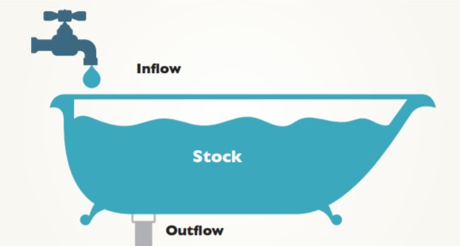

Slide 20
Eight Forms of Comprehensive Rural Wealth/Distribution
Physical
Financial
Natural
Human
Intellectual
Social
Cultural
Political

Slide 21
Characteristics of Comprehensive Wealth
Comprehensive wealth and multiple forms of capital
Financial capital
Cash, deposits, stocks, bonds, futures contracts Claims on assets held by others
Built capital
Buildings, machines, roads, bridges, parks, dams, transmission lines

Slide 22
Characteristics of Comprehensive Wealth
Comprehensive wealth and multiple forms of capital
Natural capital
Air, water, soil, forests, animals, minerals, etc.
Human capital
Education, health, skills, experience, etc.
Social capital
Social organization, networks, trust, markets, etc.

Slide 23
Characteristics of Comprehensive Wealth
Comprehensive wealth and multiple forms of capital
Intellectual capital
Knowledge, books, patents, music, etc.
Political capital
Political networks, and trust and access in these networks, etc.
Cultural capital
Art, architecture, music, literature, sense of history and place, etc.

Slide 24
Policy Implications
Importance of policies to encourage Education and good health Research
Saving Investment
Development strategies based on local assets
Place-based wealth
Attention to the distribution of income and wealth
Across groups and places
Attention to the returns to investment in public assets Relationship between public investment and private wealth creation

Slide 25

WWW.ARTOFTHERURAL.ORG
WWW.RURALGENERATION.ORG
WWW.KYRUX.ORG
WWW.OUTPOSTWINONA.ORG

Slide 26
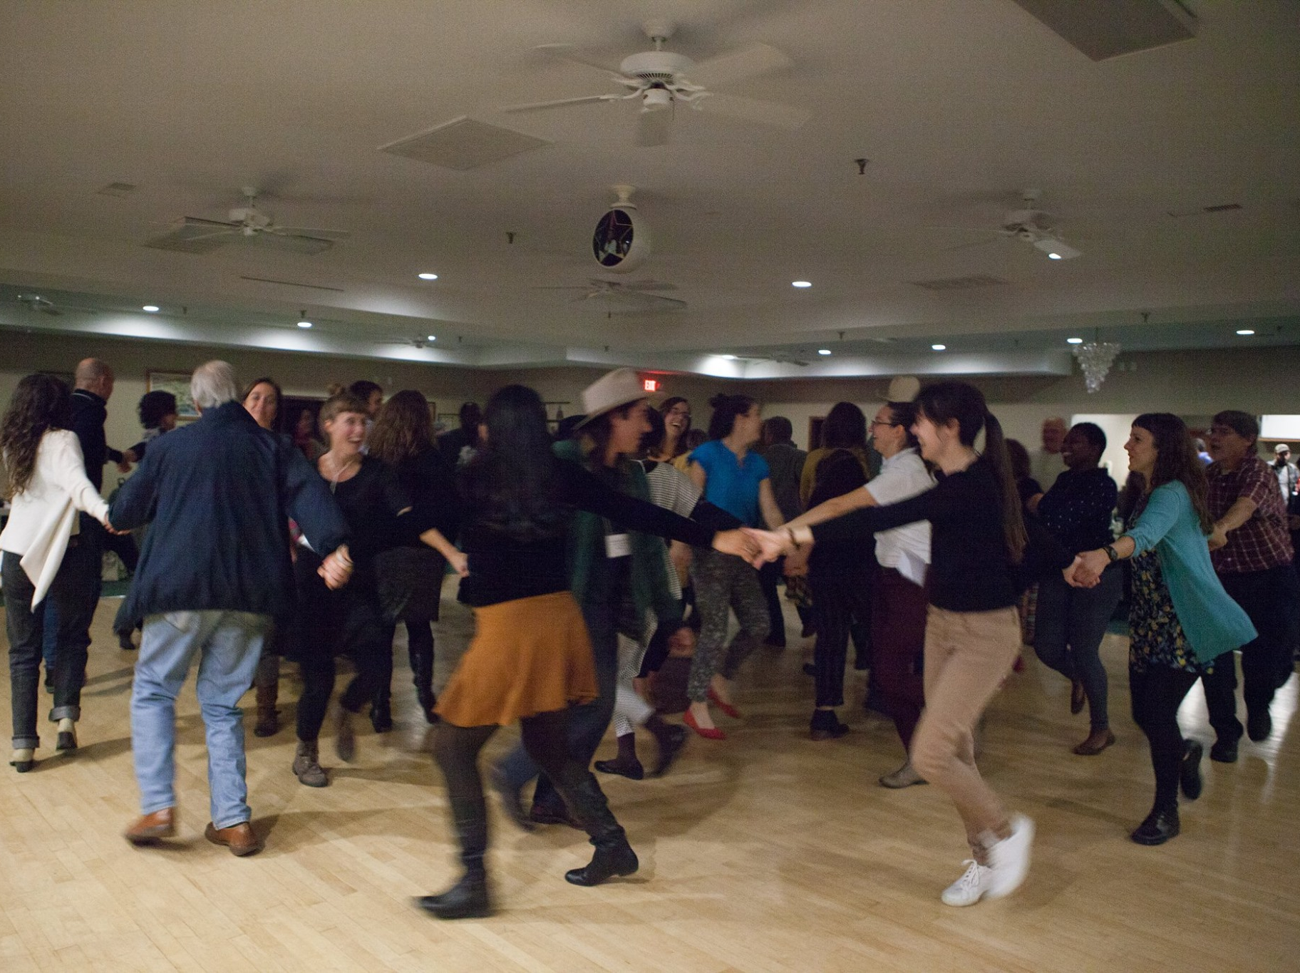
At Art of the Rural, we work to advance rural culture and quality of life through relationships that connect communities, cultivate dialogue, and forward rural-urban exchange.

Slide 27
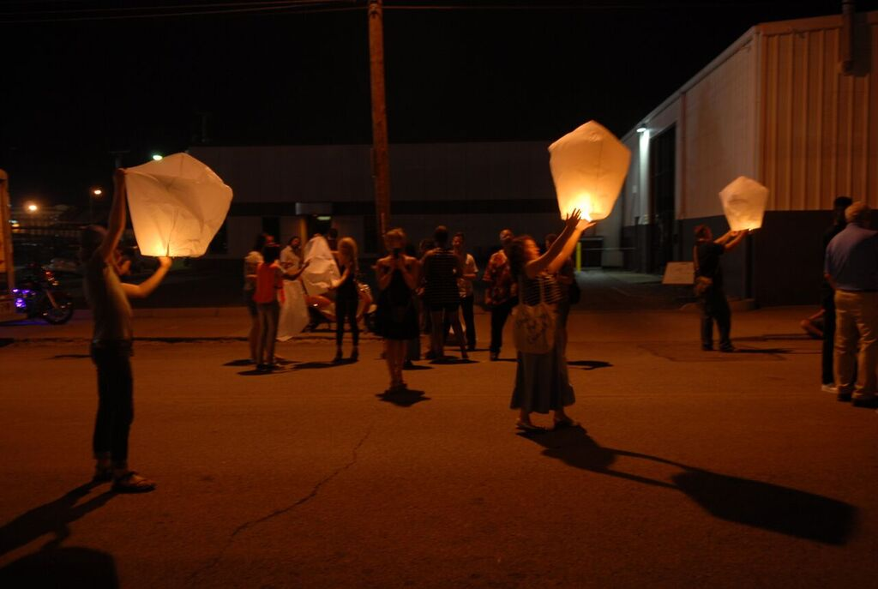



Slide 28
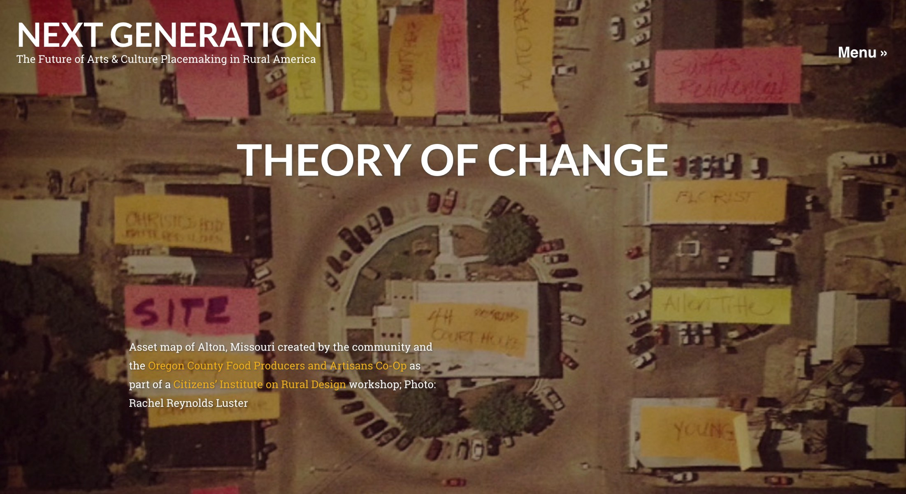
Notes:
Rural Creative Placemaking must become a central component of rural economic and community development.

Slide 29
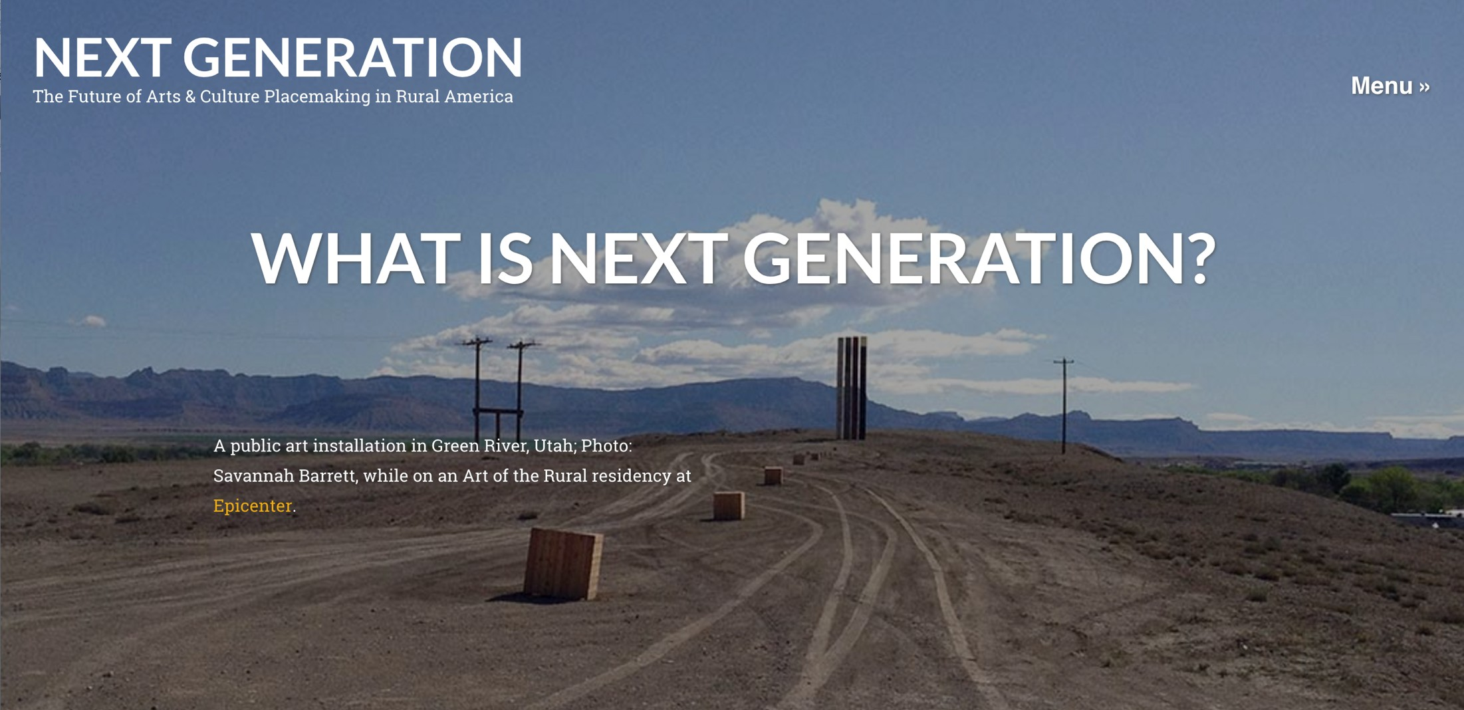
Regional Networks
Rural Creative Placemaking Summit
Digital Learning Commons

Slide 30
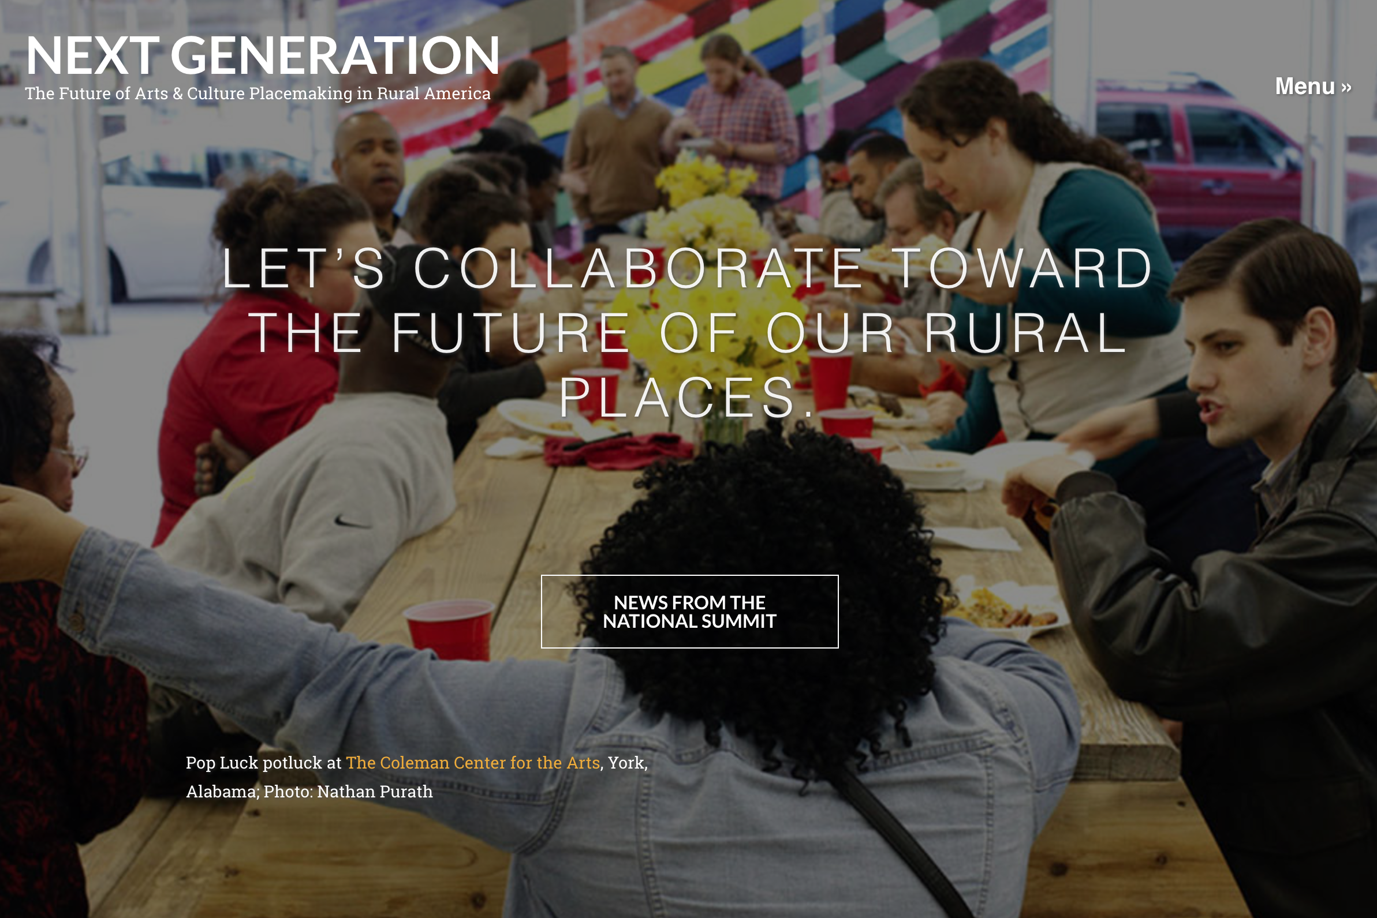

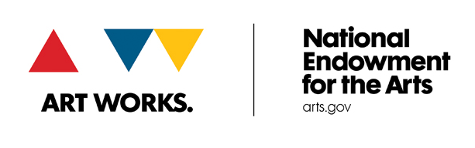

Slide 31
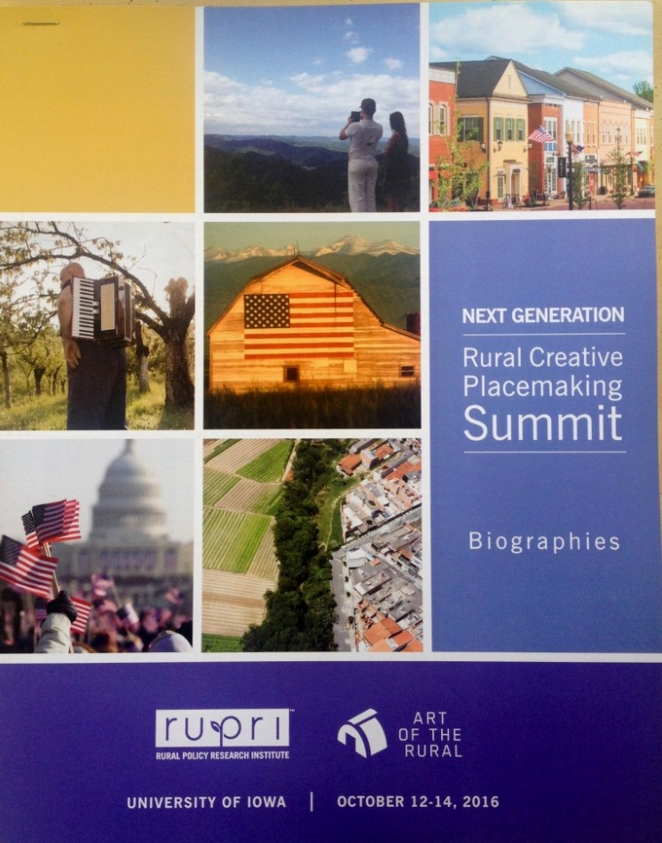
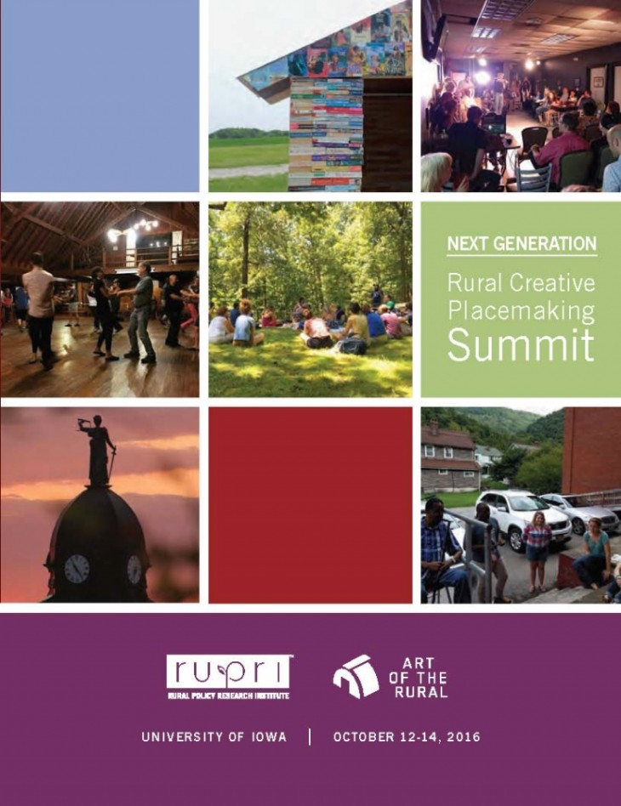

Slide 32
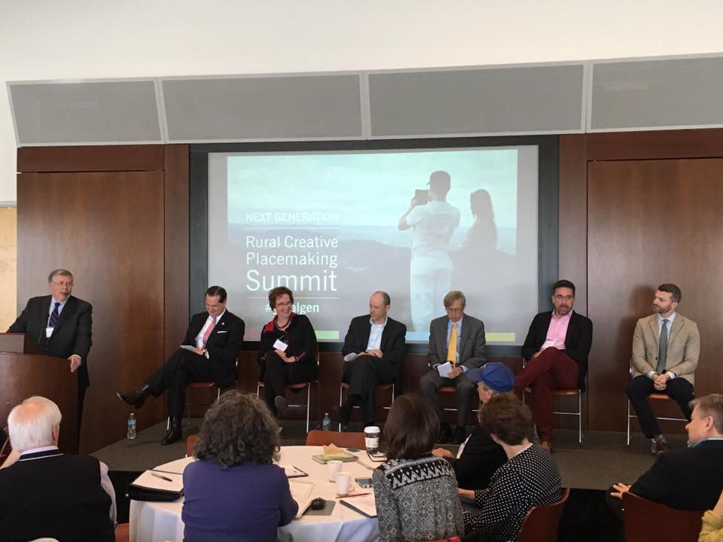

Slide 33
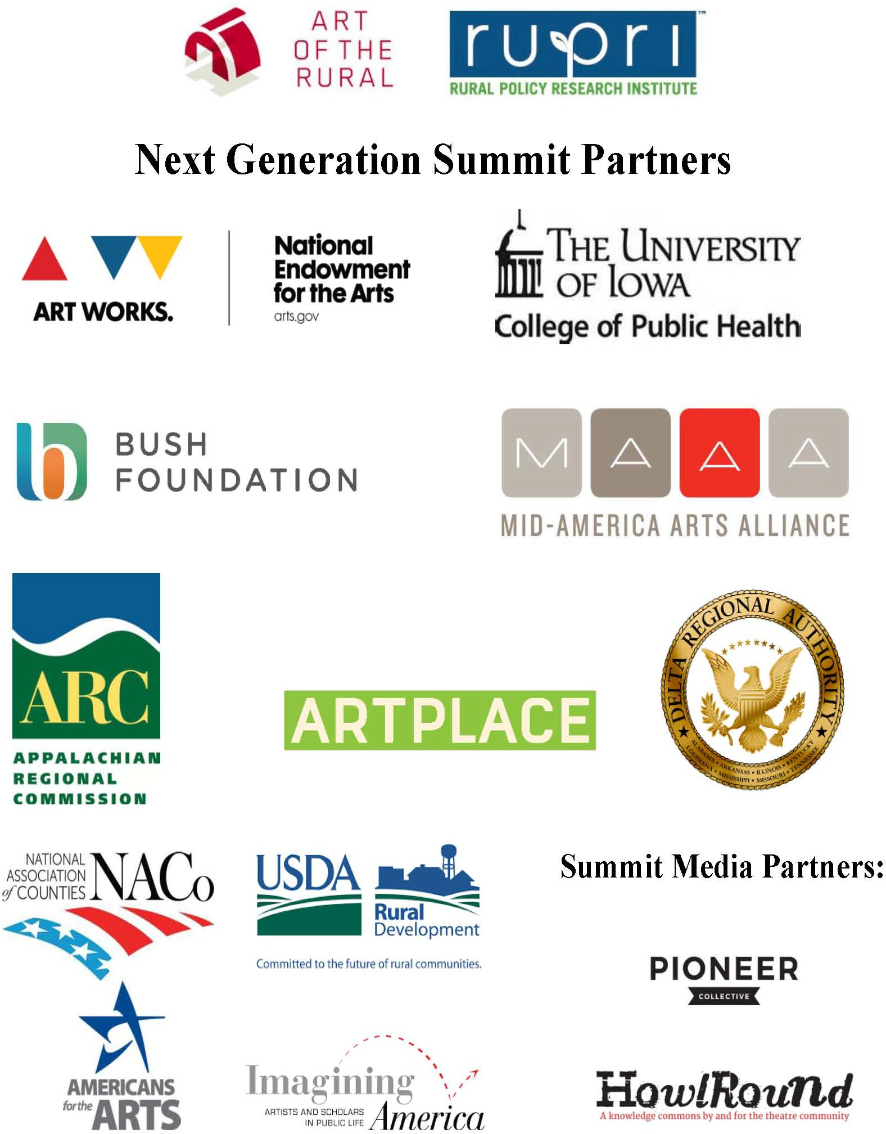

Slide 34
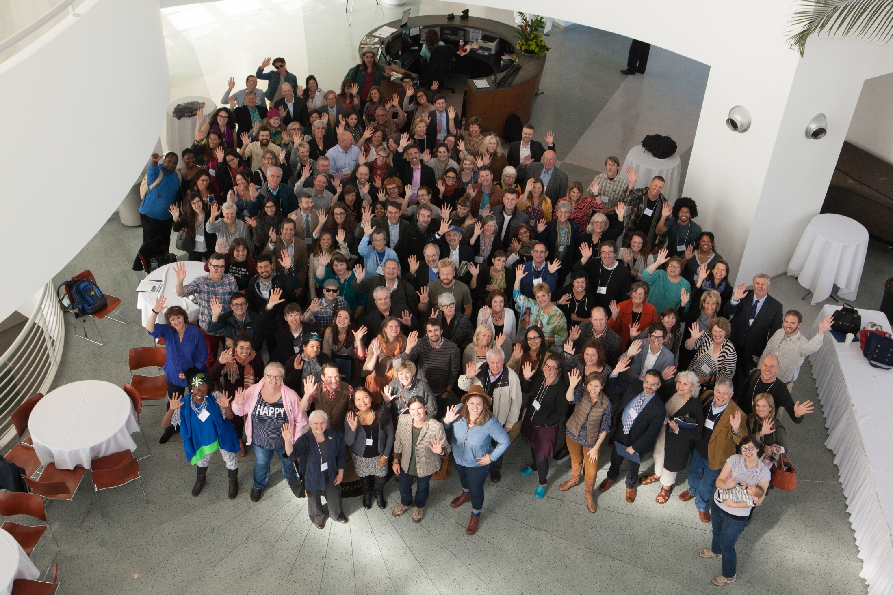
Our potential is only as strong as our connection.

Slide 35
National Rural Generation Summit across the Mississippi Delta
May 22-24, 2019
Focus: build a collective impact model that leverages our social, cultural and natural resources to address sustainability, regional cohesion, and rural quality of life.
Partners: Art of the Rural in partnership with ArtPlace America, the Center for Rural Strategies and National Rural Assembly, First Peoples Fund, the Mississippi Center for Cultural Production, the National Endowment for the Arts, the Rural Policy Research Institute, and Springboard for the Arts.
Notes:
Partners: Art of the Rural in partnership with ArtPlace America, the Center for Rural Strategies and National Rural Assembly, First Peoples Fund, the Mississippi Center for Cultural Production, the National Endowment for the Arts, the Rural Policy Research Institute, and Springboard for the Arts.

Slide 36

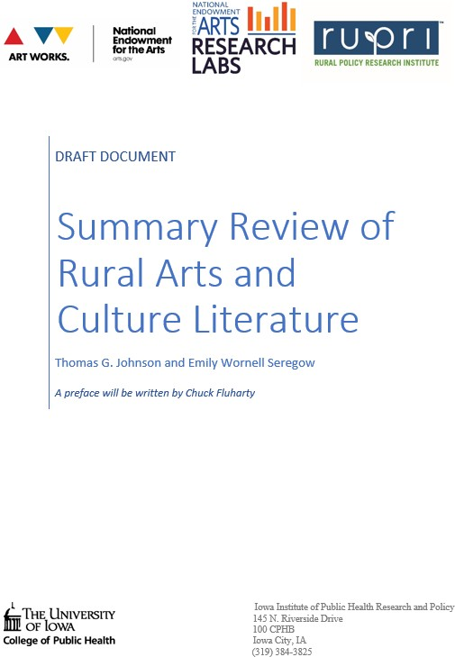
Notes:
Findings on urban normativity – not much on rural lit review
Building data measurement models
John Davis form Lanesboro Arts joining RUPRI as Bush Foundation Fellow – to push consiousness of potential to Move MN Legacy model
Rural generation Summit
Entrepreneurship and innovation research conf – cultural wealth NIFA

Slide 37

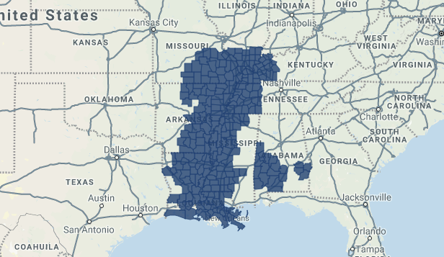

Slide 38
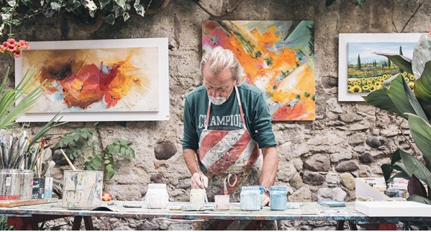
Invested in 16 projects
Notes:
600k met with 8 Governors. Regional Economic Fed funded

Slide 39
DRA Creative Placemaking Fosters
Economic Development
Revitalizes vacant and underutilized land, buildings, and infrastructure;
Supports job creation in construction, local businesses, and cultural activities;
Expands entrepreneurial ranks of artists and designers;

Slide 40

Crossroads: Change in Rural America
Supporting a National Conversation
RUPRI is partnering with Museum on Mainstreet partnership with the State Humanities Councils to work with exhibition communities in Rural America to reflect on how their community has changed and challenge them to vision their future together.

Slide 41

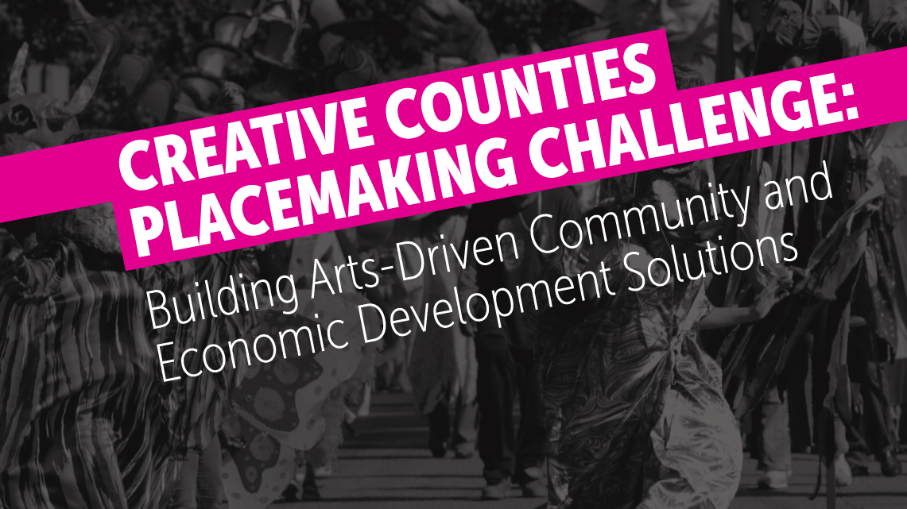

Slide 42

In 2008, Minnesota's voters passed the Clean Water, Land and Legacy Amendment (Legacy Amendment) to the Minnesota Constitution to: protect drinking water sources; to protect, enhance, and restore wetlands, prairies, forests, and fish, game, and wildlife habitat; to preserve arts and cultural heritage; to support parks and trails; and to protect, enhance, and restore lakes, rivers, streams, and groundwater.
Notes:
The Legacy Amendment increases the state sales tax by three-eighths of one percent beginning on July 1, 2009 and continuing until 2034. The additional sales tax revenue is distributed into four funds as follows: 33 percent to the clean water fund; 33 percent to the outdoor heritage fund; 19.75 percent to the arts and cultural heritage fund; and 14.25 percent to the parks and trails fund.

Slide 43
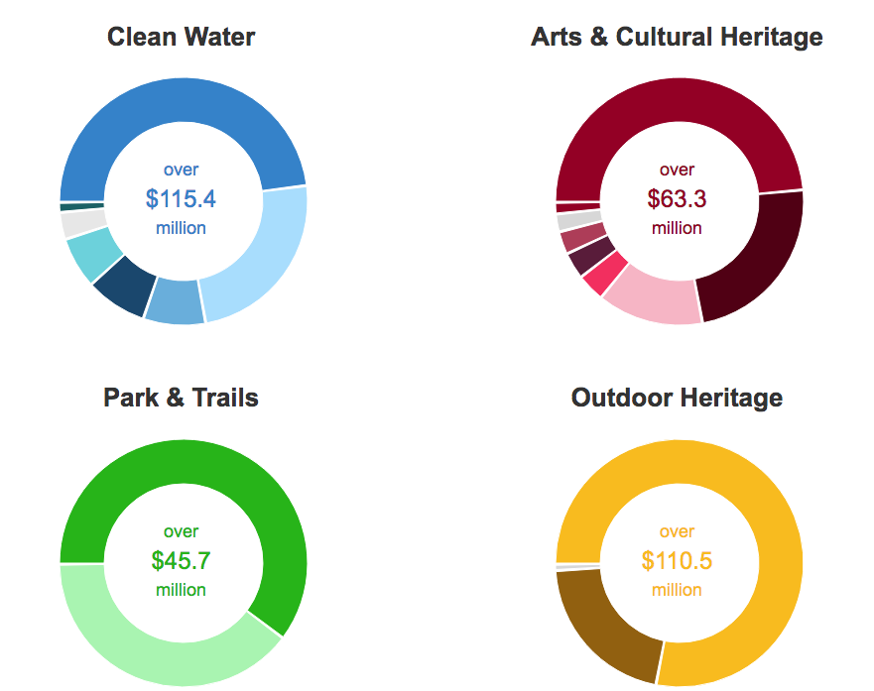

Slide 44
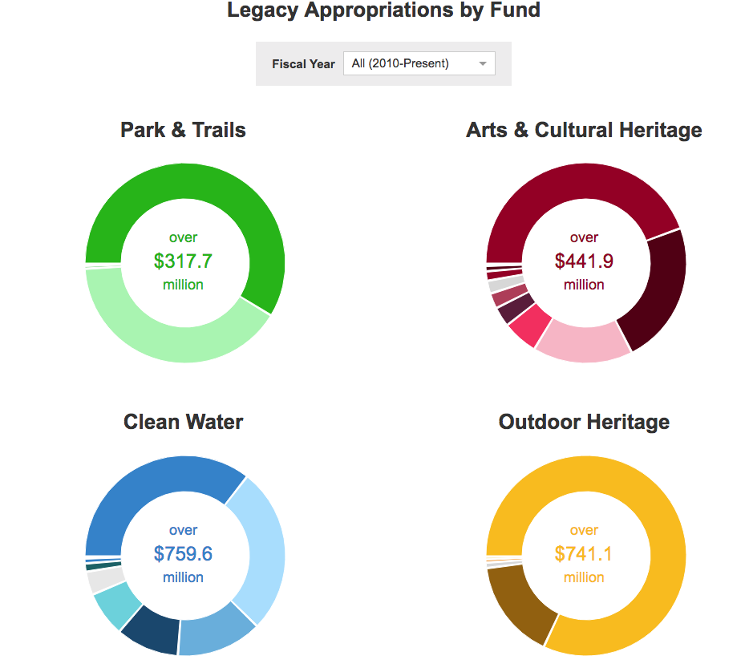

Slide 45
So, What is Rural, Anyway?

Slide 46
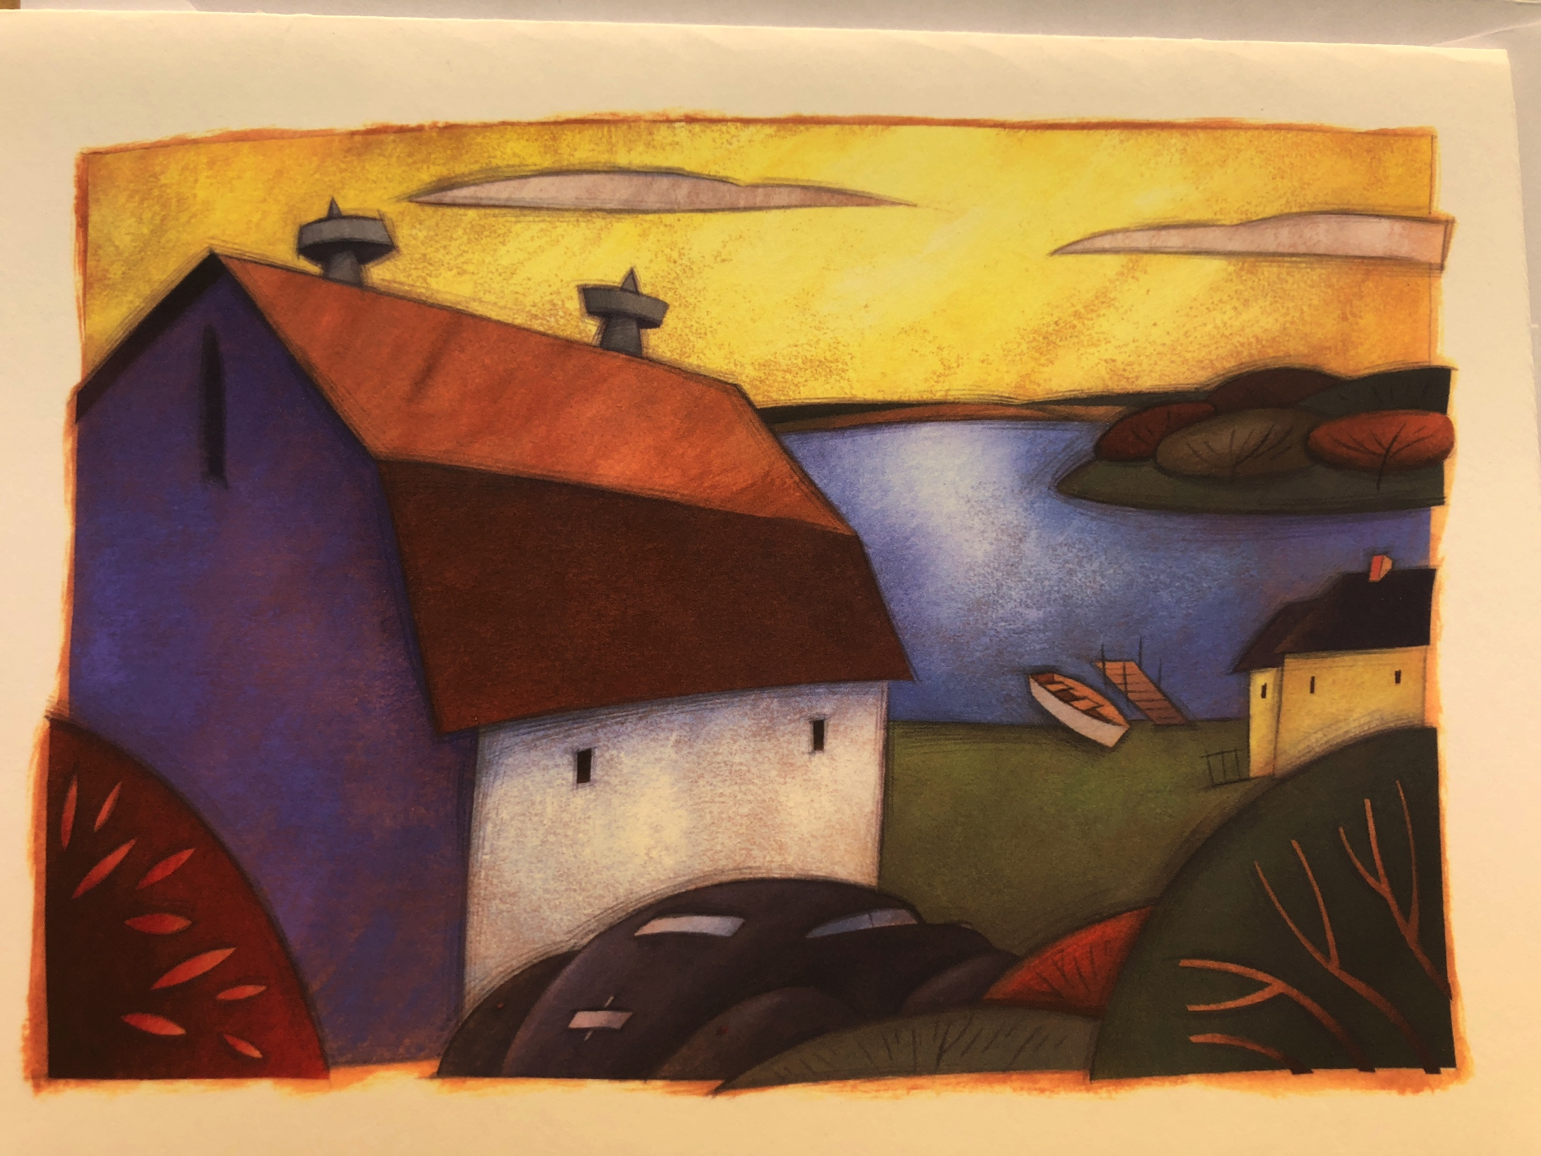
Brian Jensen Artist

Slide 47

Many of Minnesota’s city dwellers are only a generation removed from rural communities. But while personal ties to those places remain, the plight of small-town America rarely makes front-page news until there’s a crisis. Back in 1900, two-thirds of Minnesotans lived in rural areas, but by the turn of the 21st century, only a quarter of the population remained outside the state’s urban centers. According to the U.S. Census Bureau, rural counties’ populations have continued to decline over the past seven years while urban and suburban areas have grown.

Slide 48
Rural and Urban Definitions
No definition is perfect at capturing rural and urban population dynamics
  Official Census Bureau definition of urban includes places from 2,500 to several million
  OMB Core Based Statistical Areas include some very rural counties in metro areas, because of commuting patters
No categorical definition can properly capture the continuum.

Slide 49
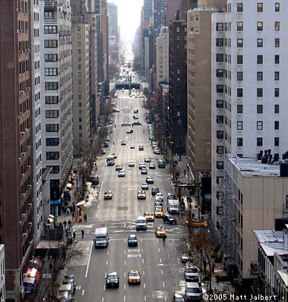
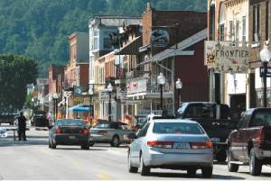
12
New York-­Newark Population 18 million
Bellevue, IA Population 2,543

Slide 50
Usually, metropolitan is equated with urban and nonmetropolitan is equated with rural.
13
So, if metropolitan is urban, then…

Slide 51
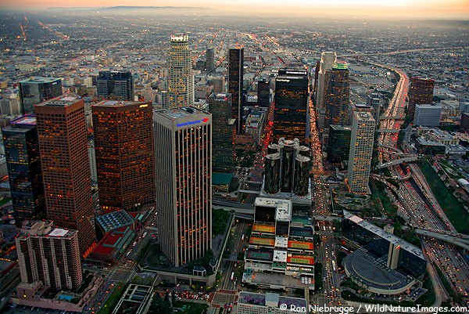
This is urban:
Los Angeles-­Long Beach-­Santa Ana, CA Metro Area Population 12.8 million

Slide 52
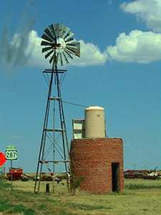
And so is this:
Armstrong County, Texas Population 1,901
Part of the Amarillo Texas Metropolitan Area

Slide 53
And if nonmetropolitan is rural, then…

Slide 54
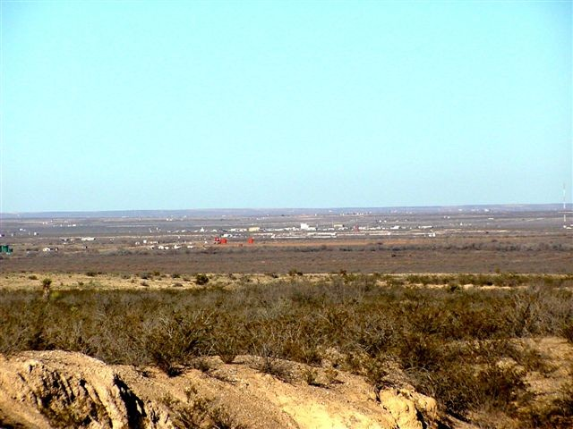
This is rural:
Loving County, Texas Population 82

Slide 55
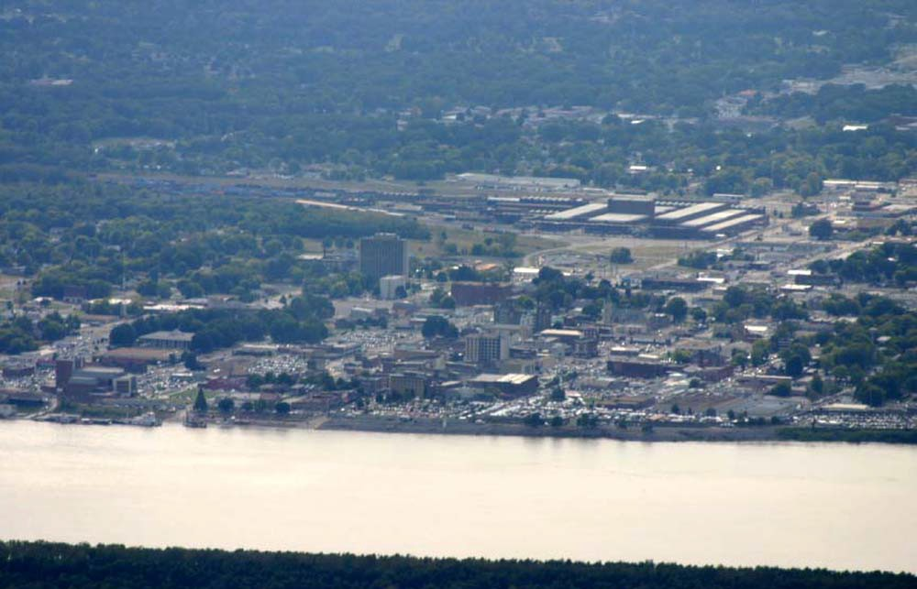
And so is this:
Paducah, Kentucky Population 48,791

Slide 56
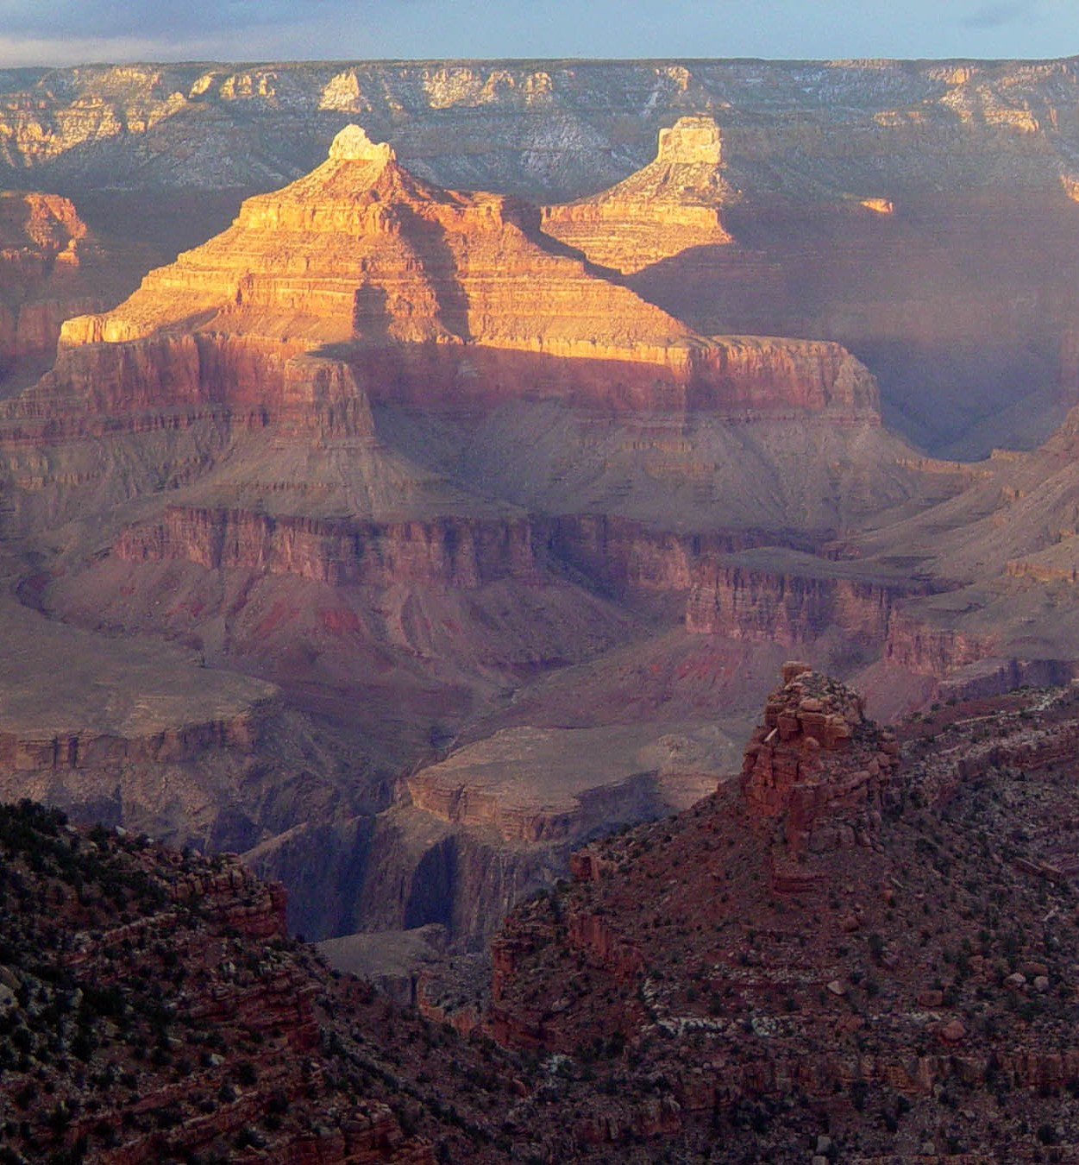
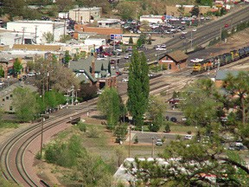
Most Counties are Urban and Rural!
Coconino County, Arizona Population 134,421 Flagstaff Metro Area

Slide 57
Most metropolitan areas contain rural territory and rural people.
In fact…
Over half of all rural people live in metropolitan counties!

Slide 58
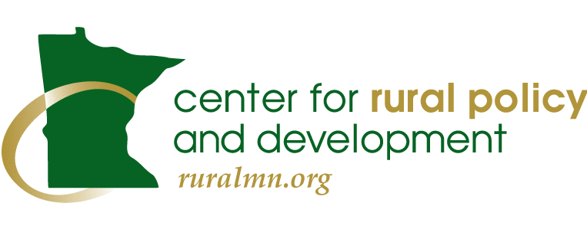
The Center for Rural Policy and Development has published its much-anticipated report, “It’s an Addiction Crisis,” with a firm reminder that meth is still the drug of choice in rural Minnesota, where it is putting a serious strain on local government, health care services, law enforcement and families.

Slide 59
Systems Thinking Re: Rural Advantage

Slide 60

The Framework for Regional Rural Innovation
New Narratives & Networks
Quality of Place
Collaborative Leadership
Knowledge Networks & Workforce
E-­ship & Innovation
Critical Internal Considerations
Wealth Creation, Intergenerational Wealth Retention, and Appropriate Wealth Distribution
Youth Engagement, Retention, and Leadership Development
Social Inclusion and Social Equity Considerations
Specific Attention to Social Mobility and Inequality

Slide 61
Three Questions:
Innovating What?
Diversifying How?
Transitioning Where?

Slide 62
Innovating What?
How “We” Consider “Us”
How We “See” Our Region
How We “Consider” Our Options
How We Support The “Connectors”

Slide 63
Diversifying How?
In Our Vision of the Future
In Our Sense of Possibility
In Our Actions and Alignments In Our New Collaborations

Slide 64
Transitioning Where?

Slide 65
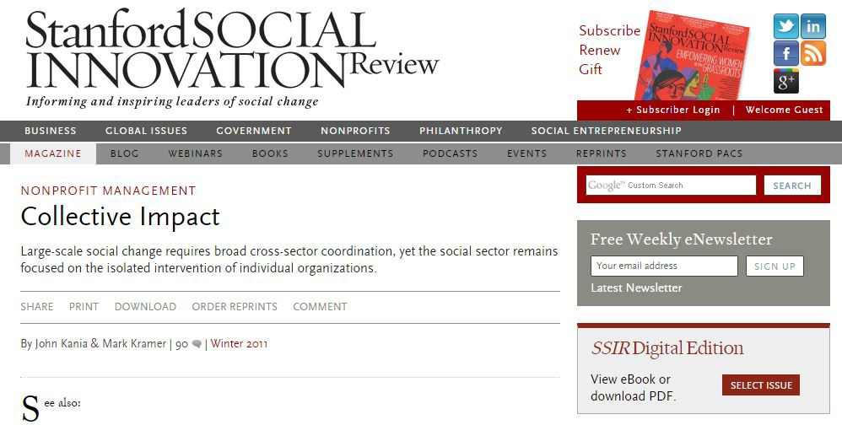

Slide 66
Five Conditions for Collective Impact Success
Common Agenda
§▪ Shared vision for change
Mutually Reinforcing Activities
§▪ Differentiated, but still coordinated
Backbone Organization
§▪ Serves entire initiative, coordinating participating organizations, firms and agencies

Slide 67
Five Conditions for Collective Impact Success (cont’d)
Continuous Communication
§▪ Consistent, open, unmediated
Rigorous and Shared Measurement
§▪ Collecting predictive indicators, regional data: then measuring ongoing results consistently

Slide 68

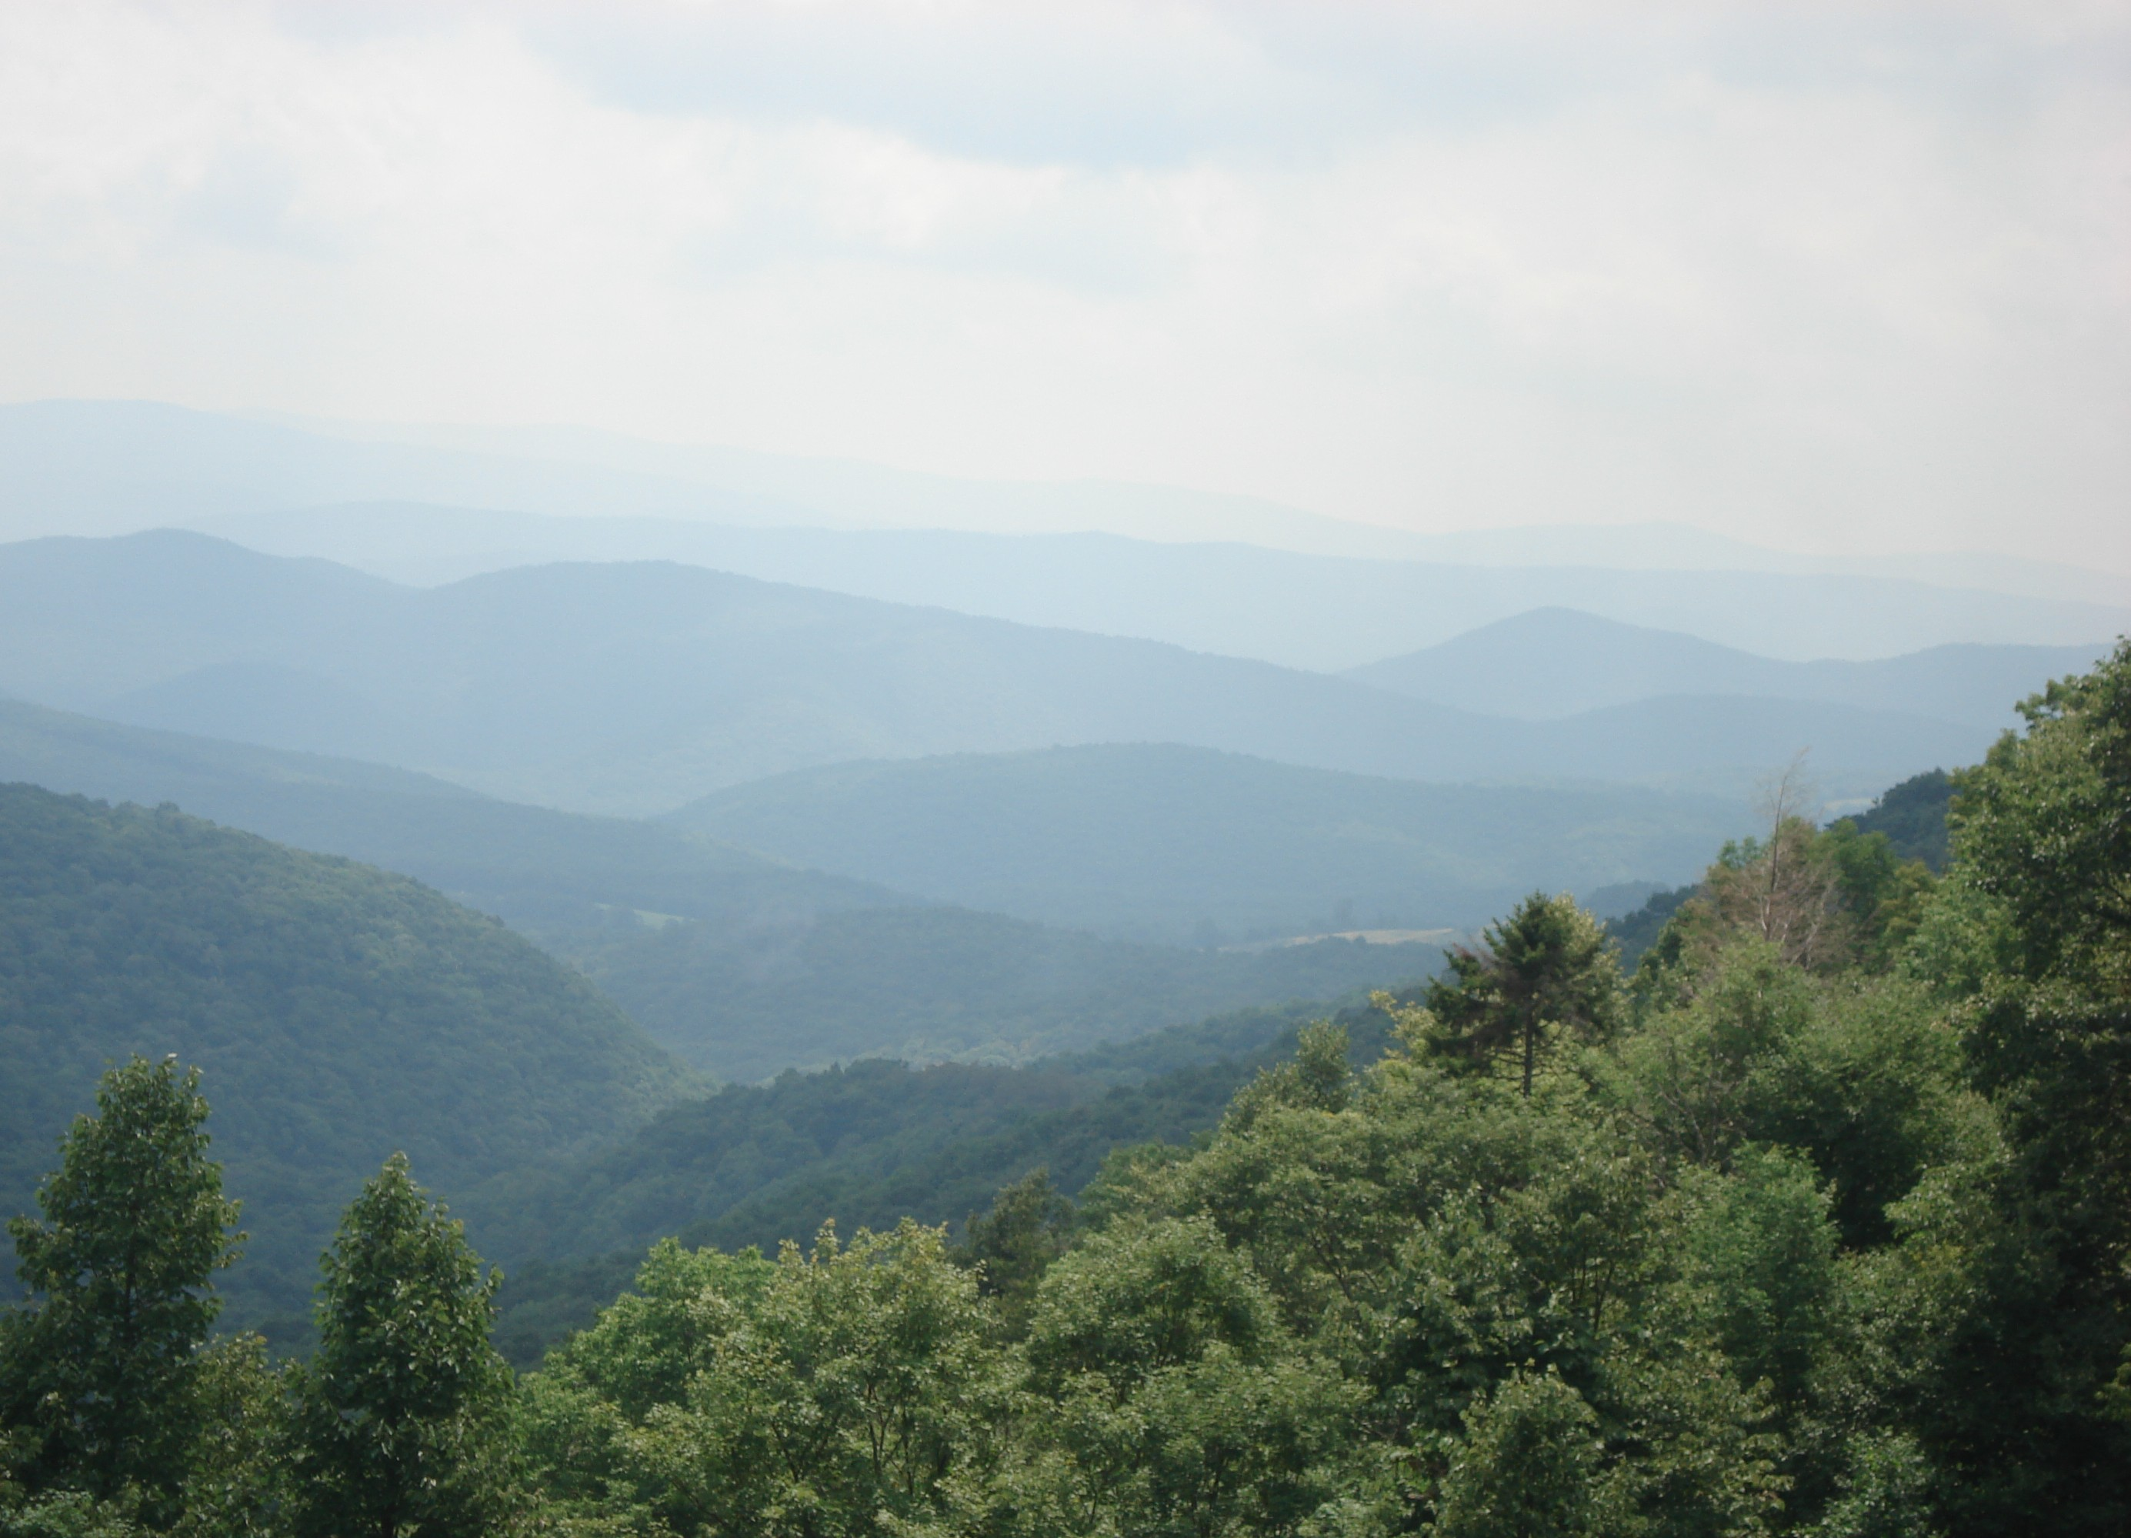


Slide 69
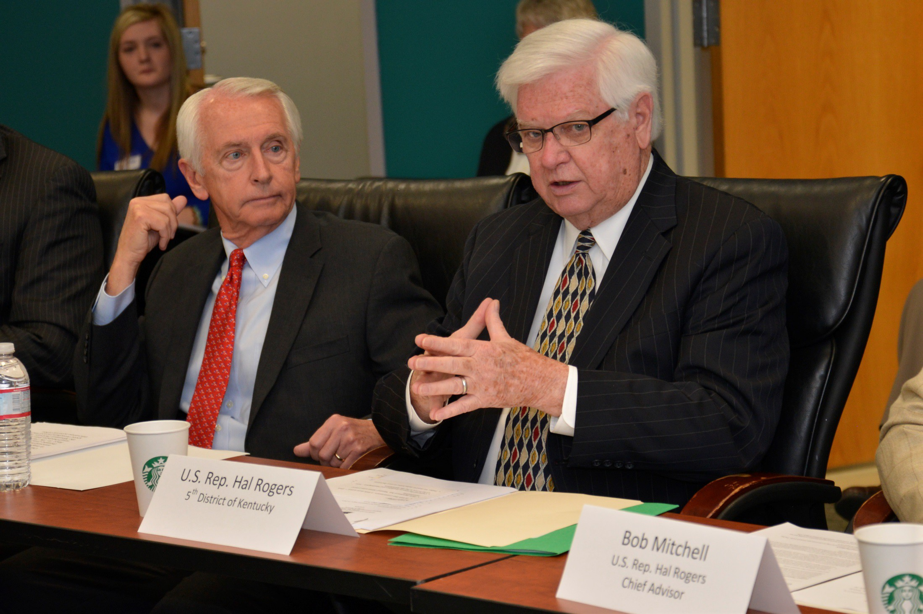

Slide 70
Another way to look at Regions in the Unites States

Slide 71
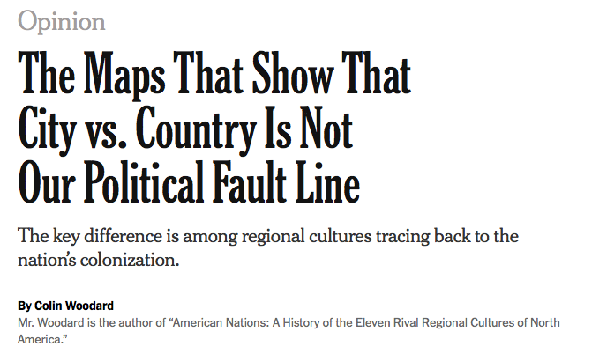

Slide 72


Slide 73


Slide 74


Slide 75
What is next for me?
100 Rural Women

Slide 76
Q & A

Slide 77
Teresa Kittridge teresa@rupri.org
Phone: 952-454-7211

