Slide 1
The Race To Value-Based Payment
Presentation to Pennsylvania Rural Health Model Summit
Keith J. Mueller, PhD
Director, RUPRI Center for Rural Health Policy Analysis
April 11 2018
Harrisburg, PA

Slide 2
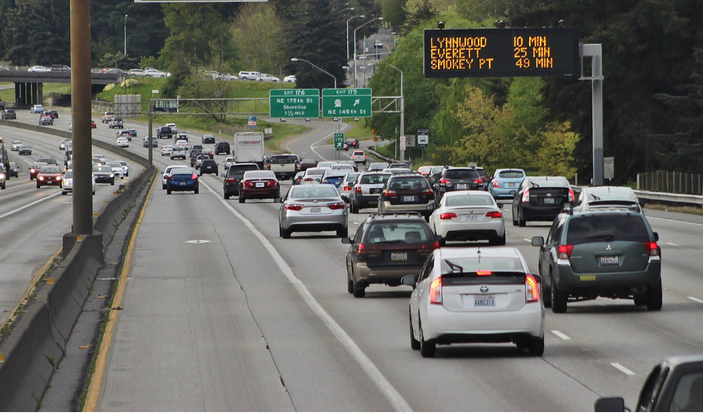
The Change in Payment
Starting line is fee-for-service (ffs), determined by allowable cost
The slow lane is to modify incrementally with incentives
Moderate lane supports elements of restructuring health finance but leaves in place current core (ffs)
Fast lane blows past current design to a total redesign of payment, aligned with quality measures

Slide 3
The Vehicles: Knowledge and Tactics
Understanding financial risk
Knowing what influences health outcomes
Managing care (patient)
Managing health (population)

Slide 4
The Driver: Health Care Organization (Hospital) Leadership
Generating resources and investing strategically
Local leadership
Facilitating coalitions

Slide 5
Policy Motivator: Cost
Total expenditure growing faster than Gross Domestic Product: crowds out other uses of GDP
Strain on national, state, local budgets
Cost of private insurance predicted to exceed $14,000 annually
What is the return on investment of this use of GDP?

Slide 6
Track 1: The Slow Lane for Providers
Incentives affecting small percentage of payment
Payment change for only a small portion of patients
Adjustments to limited number of services
Retaining the FFS payment design

Slide 7
Track 2: A Moderate Pace with Potential for More Rapid Pace: ACO Model
Fee-for-service chassis remains in place
But payment tied to total expenditures
With an element of quality measurement and accountability
Accountable Care Organization: each term has meaning

Slide 8
Why Travel Down the ACO Lane?
Opportunity to test (training wheels)
Strategic investments using advance payment or other commitments
Building delivery systems that can negotiate contracts

Slide 9
Medicare Results Are Mixed
There have been savings to the Medicare program, significance in the eyes of the beholder
Some ACOs receiving shared savings: some rural ACOs exceeding $2 million in shared savings
Quality scores have improved
Is the lane most traveled: following slides show Medicare Shared Savings Plan growth, based on beneficiaries attributed to ACOs

Slide 10
State-Level County ACO Presence and Enrollment - METROPOLITAN
 |  | 2014 |  | 2015 |  | 2016 |  | 2014-2016 Chg.
State | Counties | 1+ACO | 5%+Att. | 1+ACO | 5%+Att. | 1+ACO | 5%+Att. | 1+ACO | 5%+Att.
Connecticut | 7 | 100.0% | 100.0% | 100.0% | 100.0% | 100.0% | 100.0% | 0.0% | 0.0%
Delaware | 3 | 100.0% | 66.7% | 100.0% | 100.0% | 100.0% | 100.0% | 0.0% | 50.0%
Maine | 5 | 100.0% | 80.0% | 100.0% | 80.0% | 100.0% | 100.0% | 0.0% | 25.0%
Maryland | 19 | 100.0% | 100.0% | 100.0% | 100.0% | 100.0% | 100.0% | 0.0% | 0.0%
Massachusetts | 11 | 100.0% | 81.8% | 100.0% | 90.9% | 100.0% | 81.8% | 0.0% | 0.0%
New Hampshire | 3 | 100.0% | 100.0% | 100.0% | 100.0% | 100.0% | 100.0% | 0.0% | 0.0%
New Jersey | 21 | 100.0% | 90.5% | 100.0% | 100.0% | 100.0% | 100.0% | 0.0% | 10.5%
New York | 38 | 92.1% | 63.2% | 97.4% | 86.8% | 94.7% | 73.7% | 2.9% | 16.7%
Ohio | 38 | 94.7% | 57.9% | 100.0% | 78.9% | 100.0% | 81.6% | 5.6% | 40.9%
Pennsylvania | 37 | 73.0% | 40.5% | 100.0% | 81.1% | 100.0% | 91.9% | 37.0% | 126.7%
Rhode Island | 5 | 100.0% | 100.0% | 100.0% | 100.0% | 100.0% | 100.0% | 0.0% | 0.0%
Vermont | 3 | 100.0% | 100.0% | 100.0% | 100.0% | 100.0% | 100.0% | 0.0% | 0.0%
Virginia | 81 | 98.8% | 81.5% | 98.8% | 85.2% | 98.8% | 88.9% | 0.0% | 9.1%
West Virginia | 21 | 42.9% | 23.8% | 81.0% | 28.6% | 100.0% | 57.1% | 133.3% | 140.0%

Slide 11
State-Level County ACO Presence and Enrollment - NON-METROPOLITAN
 |  | 2014 |  | 2015 |  | 2016 |  | 2014-2016 Chg.
State | Counties | 1+ACO | 5%+Att. | 1+ACO | 5%+Att. | 1+ACO | 5%+Att. | 1+ACO | 5%+Att.
Connecticut | 1 | 100.0% | 100.0% | 100.0% | 100.0% | 100.0% | 100.0% | 0.0% | 0.0%
Delaware | 0
Maine | 11 | 100.0% | 81.8% | 100.0% | 81.8% | 100.0% | 100.0% | 0.0% | 22.2%
Maryland | 5 | 100.0% | 100.0% | 100.0% | 100.0% | 100.0% | 100.0% | 0.0% | 0.0%
Massachusetts | 3 | 100.0% | 33.3% | 66.7% | 33.3% | 66.7% | 0.0% | -33.3% | -100.0%
New Hampshire | 7 | 100.0% | 85.7% | 100.0% | 100.0% | 100.0% | 100.0% | 0.0% | 16.7%
New Jersey | 0
New York | 24 | 75.0% | 50.0% | 100.0% | 87.5% | 100.0% | 87.5% | 33.3% | 75.0%
Ohio | 50 | 74.0% | 40.0% | 94.0% | 56.0% | 100.0% | 80.0% | 35.1% | 100.0%
Pennsylvania | 30 | 73.3% | 36.7% | 96.7% | 60.0% | 93.3% | 63.3% | 27.3% | 72.7%
Rhode Island | 0
Vermont | 11 | 100.0% | 100.0% | 100.0% | 100.0% | 100.0% | 100.0% | 0.0% | 0.0%
Virginia | 53 | 96.2% | 77.4% | 100.0% | 84.9% | 96.2% | 84.9% | 0.0% | 9.8%
West Virginia | 34 | 23.5% | 11.8% | 73.5% | 35.3% | 97.1% | 64.7% | 312.5% | 450.0%

Slide 12
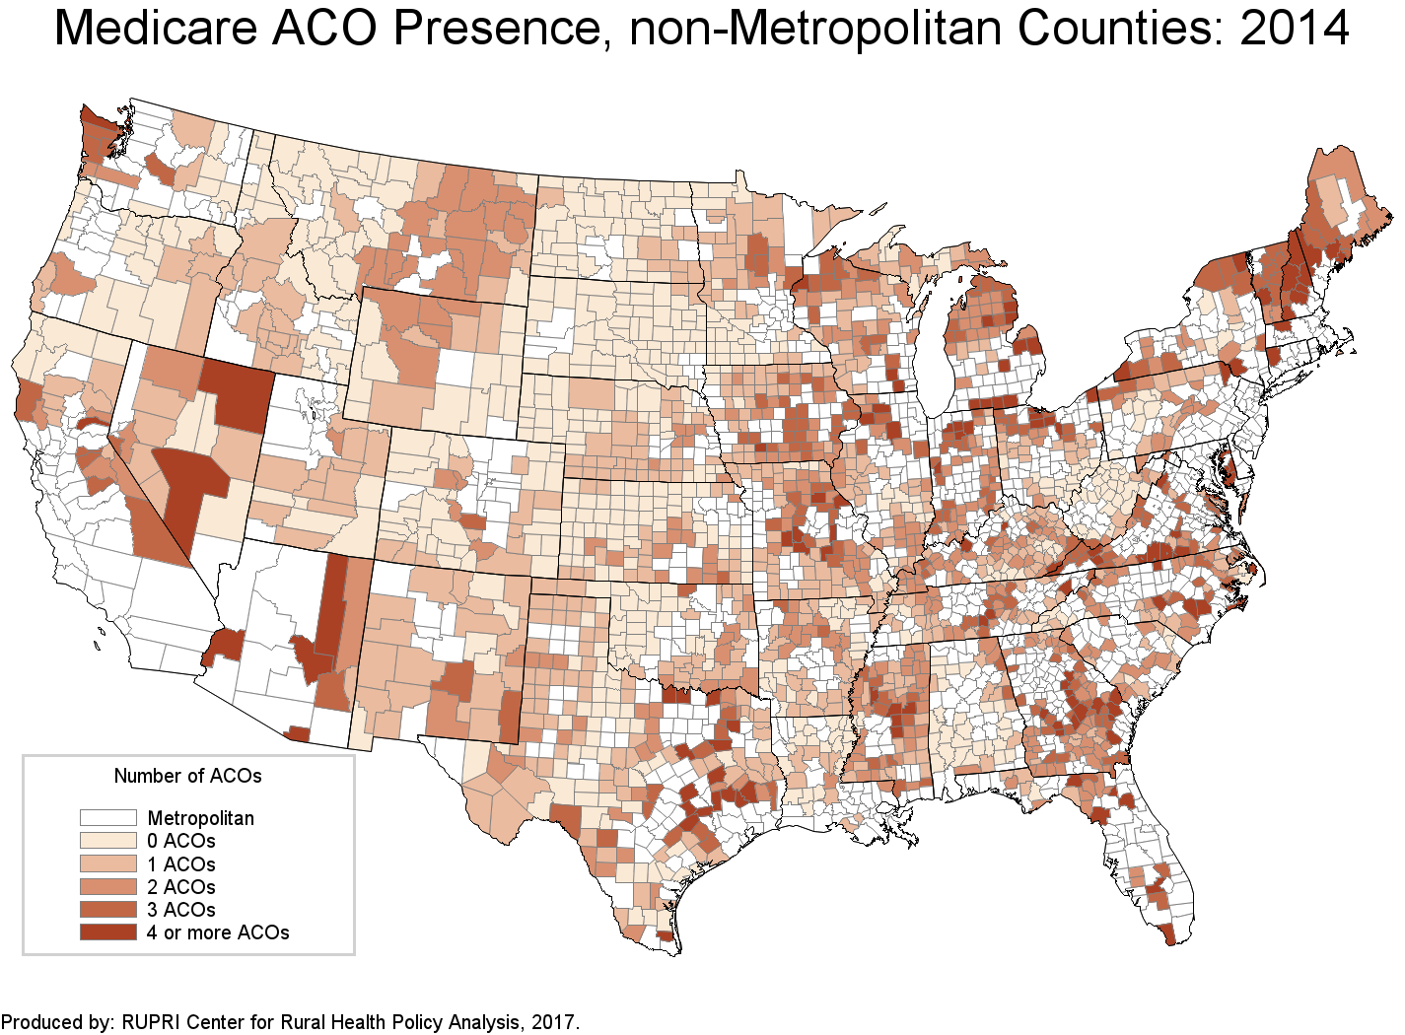

Slide 13
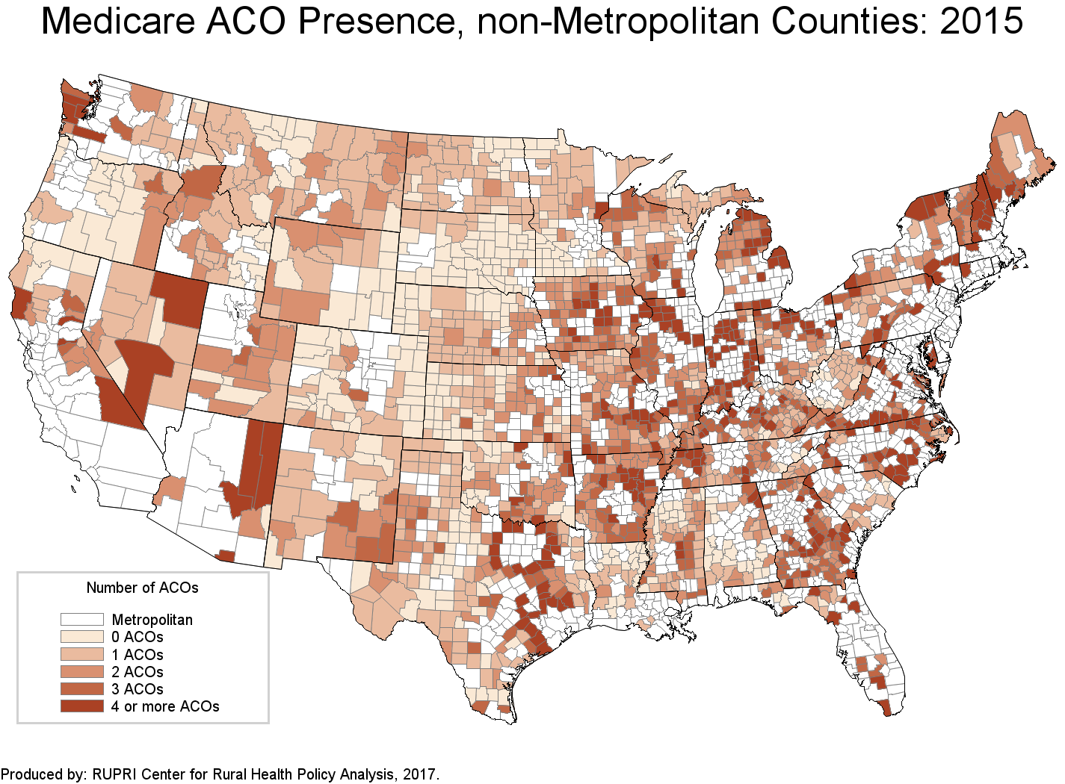

Slide 14
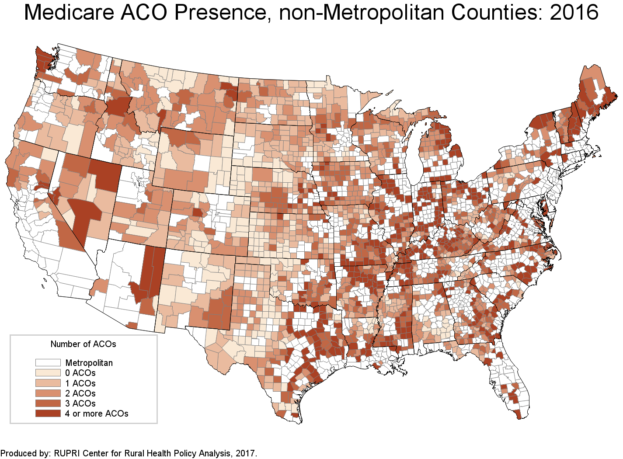

Slide 15
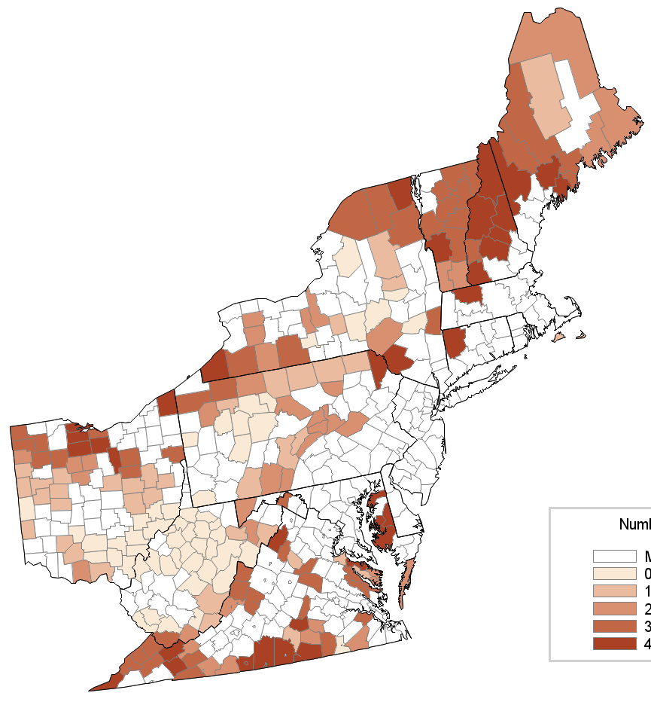
Medicare ACO Presence,
non-Metropolitan Counties: 2014

Slide 16
Medicare ACO Presence,
non-Metropolitan Counties: 2015

Slide 17
Medicare ACO Presence,
non-Metropolitan Counties: 2016

Slide 18
Fast Lane to Controlling Cost: Fixed Cost Contracting
Managed Care Organization (MCO) contracts in Medicaid programs
Fixed budget between states and MCOs, “negotiated” prices between MCOs and providers
MCO managing care: utilization generally and use of specific services
Medicare approach with Medicare Advantage plans (MA): combine quality scoring with payment, resulting in higher outlay
Provider payment determined by the MA plan

Slide 19
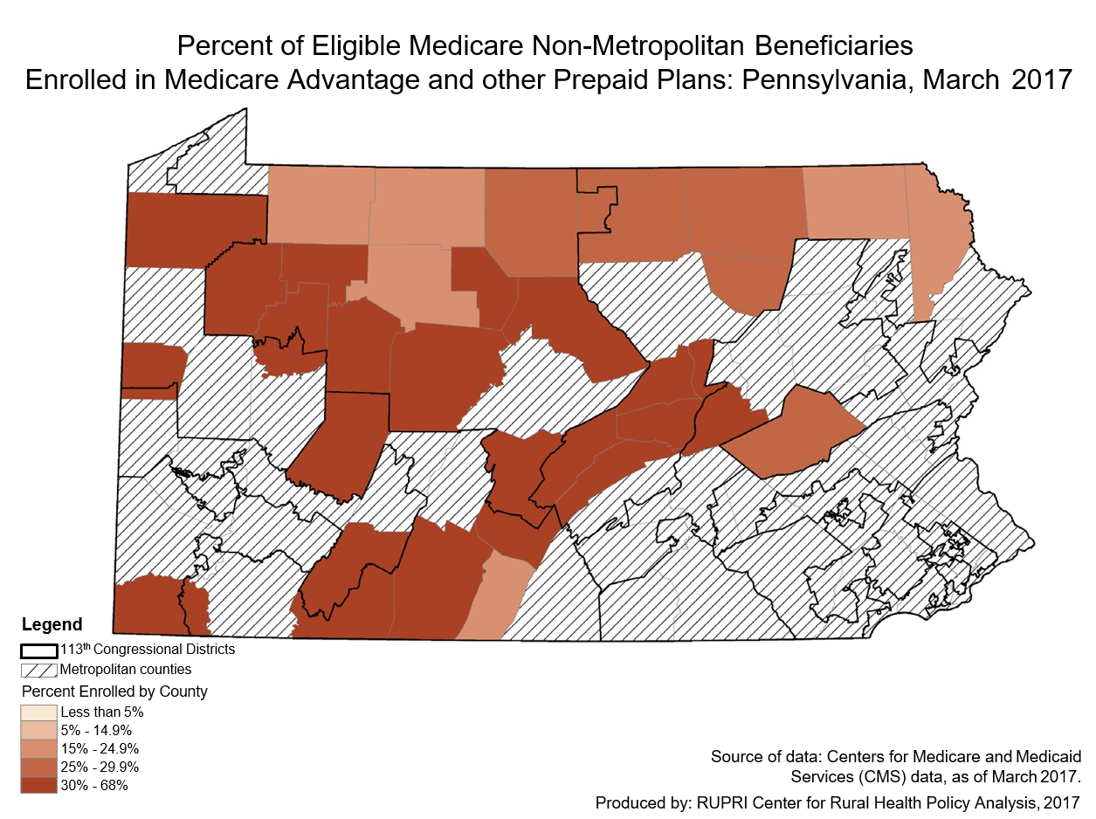

Slide 20
Track 3, Fast Lane: Global Budgeting in Maryland
Meeting the spending targets of the demonstration (rate of growth below that of the state’s economy)
Total Medicare savings of $429 million 2013 – 2016; net savings of $319 million
Quality measures also improving
Source: Nelson Sabatini, Joseph Antos, Howard Haft, and Donna Kinzer. “Maryland’s All-Payer Model—Achievements, Challenges, and Next Steps.” Health Affairs Blog. January 31, 2017.

Slide 21
Track 3, Fast Lane: Global Budgeting in Maryland
The story of McCready Health in Crisfield, population 2,726 (service area approximately 7,.000)
Increased capital investments
Build new services
“The switch from volume payment to value payment is driving McCready to understand and improve the health status of its populations”
Sources: Joy A. Strand. “Global Budget in a Rural Hospital.” Presentation to the NRHA CAH Conference. September 22, 2016
“Global Budget Process as an Alternative Payment Model.” Rural Innovation Profile. Rural Health Value. www.ruralhealthvalue.org.

Slide 22
Track 3: Fast Lane: Direct Contracting
System-owned insurance plans
Contract directly with large groups
Develop products for exchanges
Other: could be association plans

Slide 23
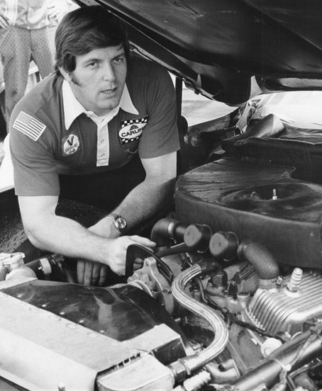
Building the Race Car: Engine is Finance
Current finance: pro forma
Operating in a shared savings environment
Understanding cross-payer issues (helps tremendously to be an all-payer demonstration)
Operating at full risk
Crucial to keep it lubricated: in McCready biweekly meetings of CEO and CFO to make rate adjustments

Slide 24
The Wheels for the Car
Community partnerships
Maintains continuous progress toward community health objectives
Maintaining tire pressure: spreading resources to meet health needs through the appropriate agency

Slide 25
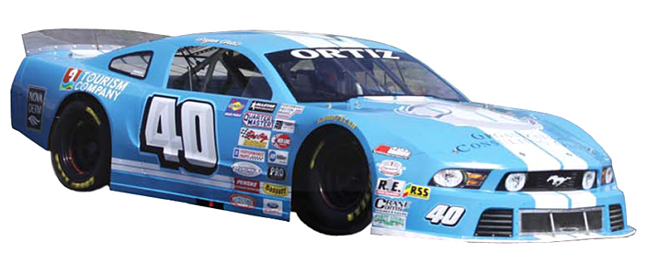
The Body of the Car: Strategies and Tactics
Care management for high risk patients
Identifying pressure points driving expenditures and work to control (readmissions down in MD; “high flyers” in emergency rooms)
Population health measures to achieve community health goals

Slide 26
Tactics: Community-Wide Efforts
The Heart of New Ulm Project lead by the New Ulm Medical Center (CAH): 36-member steering committee from multiple sectors focused on healthy lifestyle behaviors; diet, daily aspirin, exercise – will impact utilization
Mt Ascutney Hospital and Health Center in Windsor, VT (CAH) formed community health infrastructure to close fragmented and decentralized care services, establishing new infrastructure and programs; result is 34,248 individuals receiving assistance in social services and numerous antidrug programs being introduced; needed to build trust with community partners, sharing credit
Source: “The Role of Small and Rural Hospitals and Care Systems in Effective Population Partnerships” Health Research and Educational Trust, AHA. June, 2013.
Dansville, NY Noyes Health: in healthiest county in NY; work with community partners across the continuum of care; from CEO: “We no longer see ourselves as a standalone organization, but rather as part of the region’s broader healthcare ecosystem.”
Source: Ellie Rizzo, “Population Health Lessons from Hospitals in the U.S.’ Healthiest Counties: 3 CEOs Share Successes.” Becker’s Hospital Review June 2, 2014)

Slide 27
Tactics: Addressing Patient Social Needs
Winona MN hospital: network formed to support chronically ill individuals with services that included purchasing meals post discharge: ED visits fell 91% in first three months, readmission rates 94%
Source: Rite Pyrillis, “Rural Hospitals Innovate to Meet New Health Care Challenges.” Hospitals and Health Networks. January 13, 2015)
St Joseph’s Hospital in Highland, IL: rigorous discharge review, including daily huddles during inpatient stay
Source: John Commins, “This Tiny CAH Says ‘No Excuses’” HealthLeaders Media September 16, 2015)
Anson County hospital in North Carolina: designed hospital to improve communication, patient flow and create a “healing environment”; use medical home approach to care; use community health advocates and patient navigators
Source: “Re-envisioning the Rural Hospital. North Carolina Health News. July 31, 2015)

Slide 28
Tactics: Population Health
Garden City, KS St. Catherine Hospital formed Finney County Community Health Coalition, was awarded a grant in 2007, results: drop in teen binge drinking, grew into new 501(c)(3) organization that had success with no-smoking ordinance, bus service, child health initiatives
Source: “Garden City harvests a thriving crop of community health improvement projects.” AHA News September 12, 2014)
Employee wellness program in Mason District Hospital, Havanna, IL saved money for the hospital and improved community health; KishHealth System in DeKalb IL using CHNA to influence programming
Source: Melissa Henriksen and Norman Walzer. “Illinois Critical Access Hospitals: Managing Healthy Communities in Rural Illinois.” Rural Health Care White Paper Series: Issue 3 Northern Illinois Center for Governmental Studies. October, 2013.

Slide 29
Conclusion
The tracks are still being defined, especially track 3
The shift to track 3 is underway, but at different paces in different places and from different payers
Lots of pieces already in place or available to build and drive the car

Slide 30
For further information
The RUPRI Center for Rural Health Policy Analysis
http://cph.uiowa.edu/rupri
The RUPRI Health Panel
http://www.rupri.org
Rural Telehealth Research Center
http://ruraltelehealth.org/
The Rural Health Value Program
http://www.ruralhealthvalue.org

Slide 31
Keith Mueller, PhD
Interim Dean, College of Public Health
Gerhard Hartman Professor, Health Management & Policy
Director, RUPRI Center for Rural Health Policy Analysis
145 Riverside Drive, S153A, CPHB
Iowa City, IA 52242
319-384-1503
keith-mueller@uiowa.edu

Slide 32
Collaborations to Share and Spread Innovation
The National Rural Health Resource Center https://www.ruralcenter.org/
The Rural Health Information Hub
https://www.ruralhealthinfo.org/
The National Rural Health Association
https://www.ruralhealthweb.org/
The National Organization of State Offices of Rural Health
https://nosorh.org/
The American Hospital Association
http://www.aha.org/

Slide 33
The Rural Health Research Gateway provides access to all publications and projects from eight different research centers. Visit our website for more information.
ruralhealthresearch.org
Sign up for our email alerts!
ruralhealthresearch.org/alerts
Center for Rural Health
University of North Dakota
501 N. Columbia Road Stop 9037
Grand Forks, ND 58202

