Slide 1


Creative Cities/Creative Countrysides: “Rural Cities”, Micropolitan Regions, and Next Generation Rural Creative Placemaking
Presented to the
Main Street Ottumwa Better Block Summit
October 11, 2017
Charles W. Fluharty
President & CEO
Rural Policy Research Institute

Slide 2

Today’s Considerations
Rethinking Rural Wealth, Sustainable Economic Development and Cultural Equity
Micropolitan Leadership in Rural/Urban Collaboration and Place-Based, Cultural and Natural Resource Wealth Retention
The Ottumwa Opportunity

Slide 3
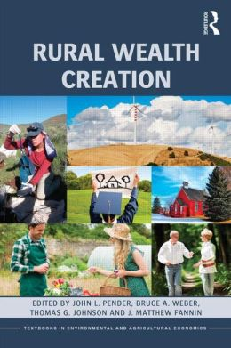
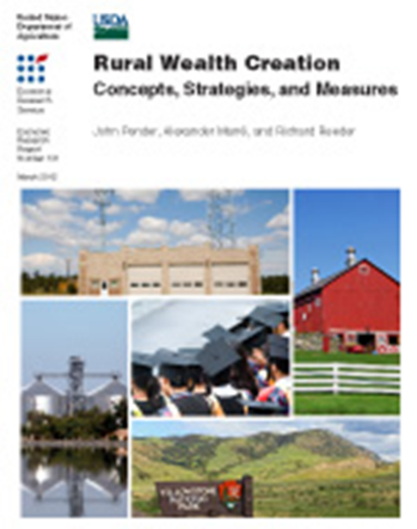

Reframing Sustainable Rural Wealth

Slide 4

Eight Forms of Rural Wealth
Physical
Financial
Natural
Human
Intellectual
Social
Cultural
Political

Slide 5
The Framework for Regional Rural Innovation
New
Narratives
& Networks
Quality of
Place
Collaborative
Leadership
Knowledge Networks & Workforce
E-ship & Innovation
Critical Internal Considerations
Wealth Creation, Intergenerational Wealth Retention, and Appropriate Wealth Distribution
Youth Engagement, Retention, and Leadership Development
Social Inclusion and Social Equity Considerations
Specific Attention to Social Mobility and Inequality

Slide 6
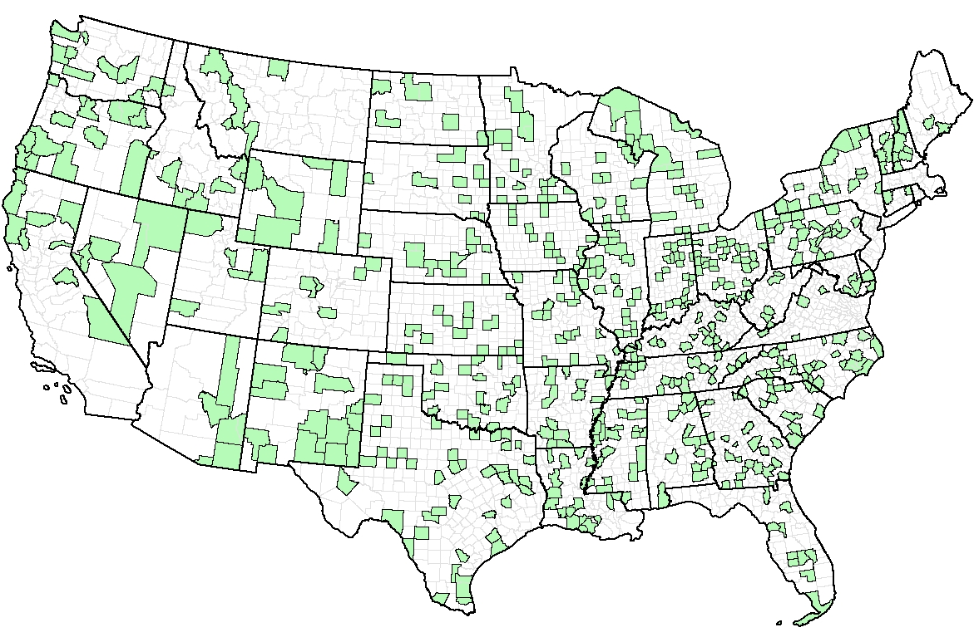
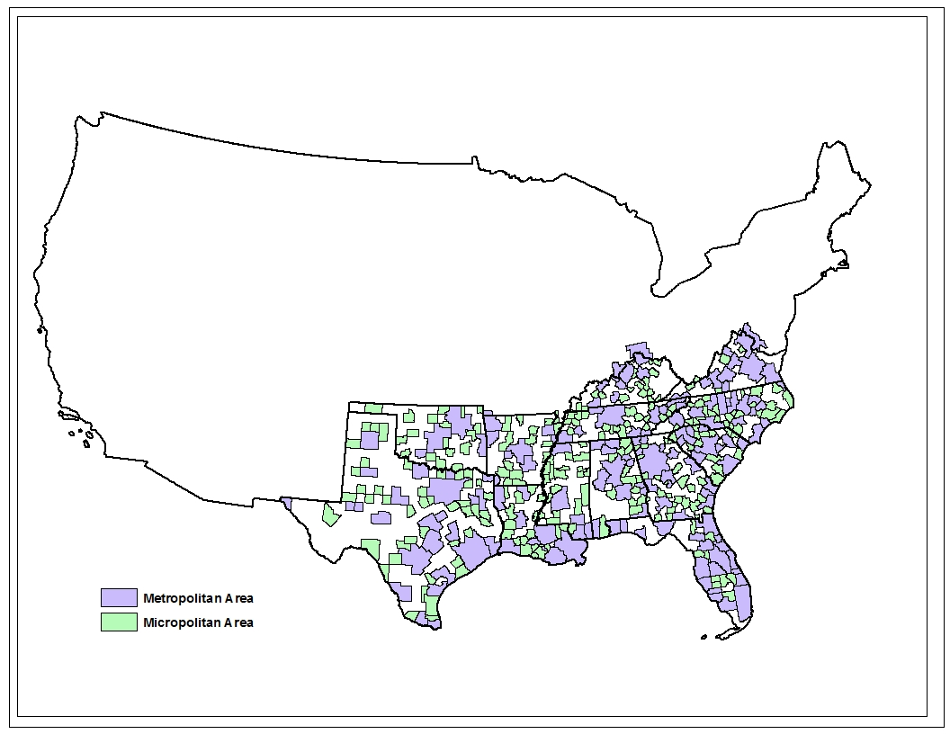
US Micropolitan Areas, 2010

Slide 7
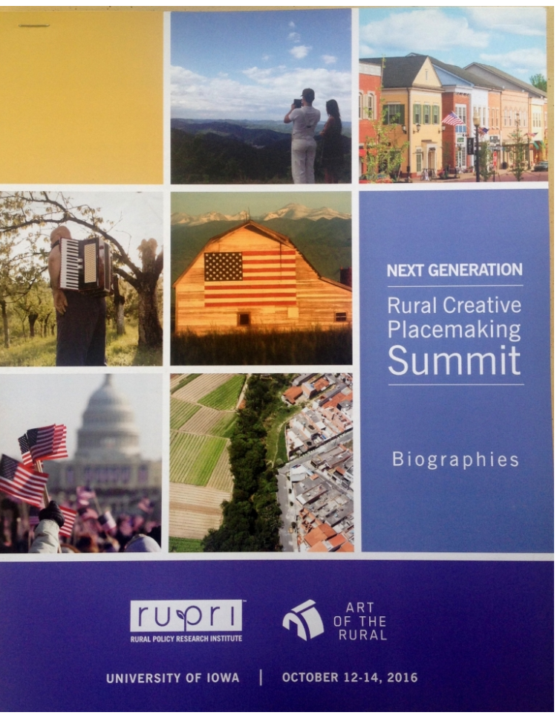
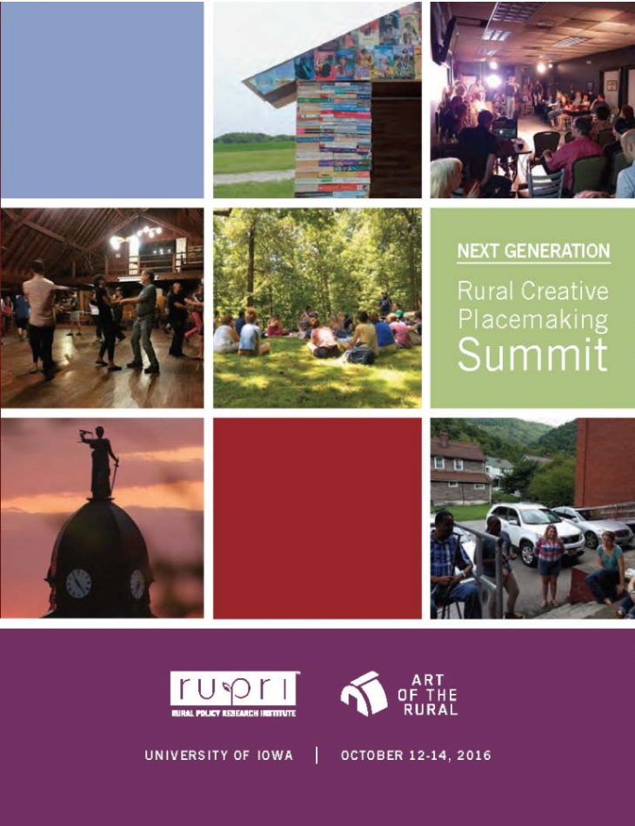

Slide 8
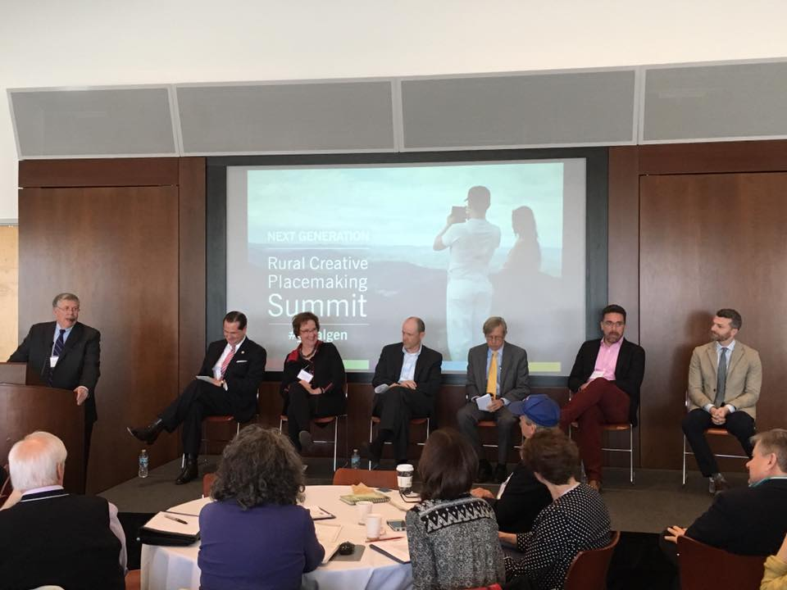

Slide 9
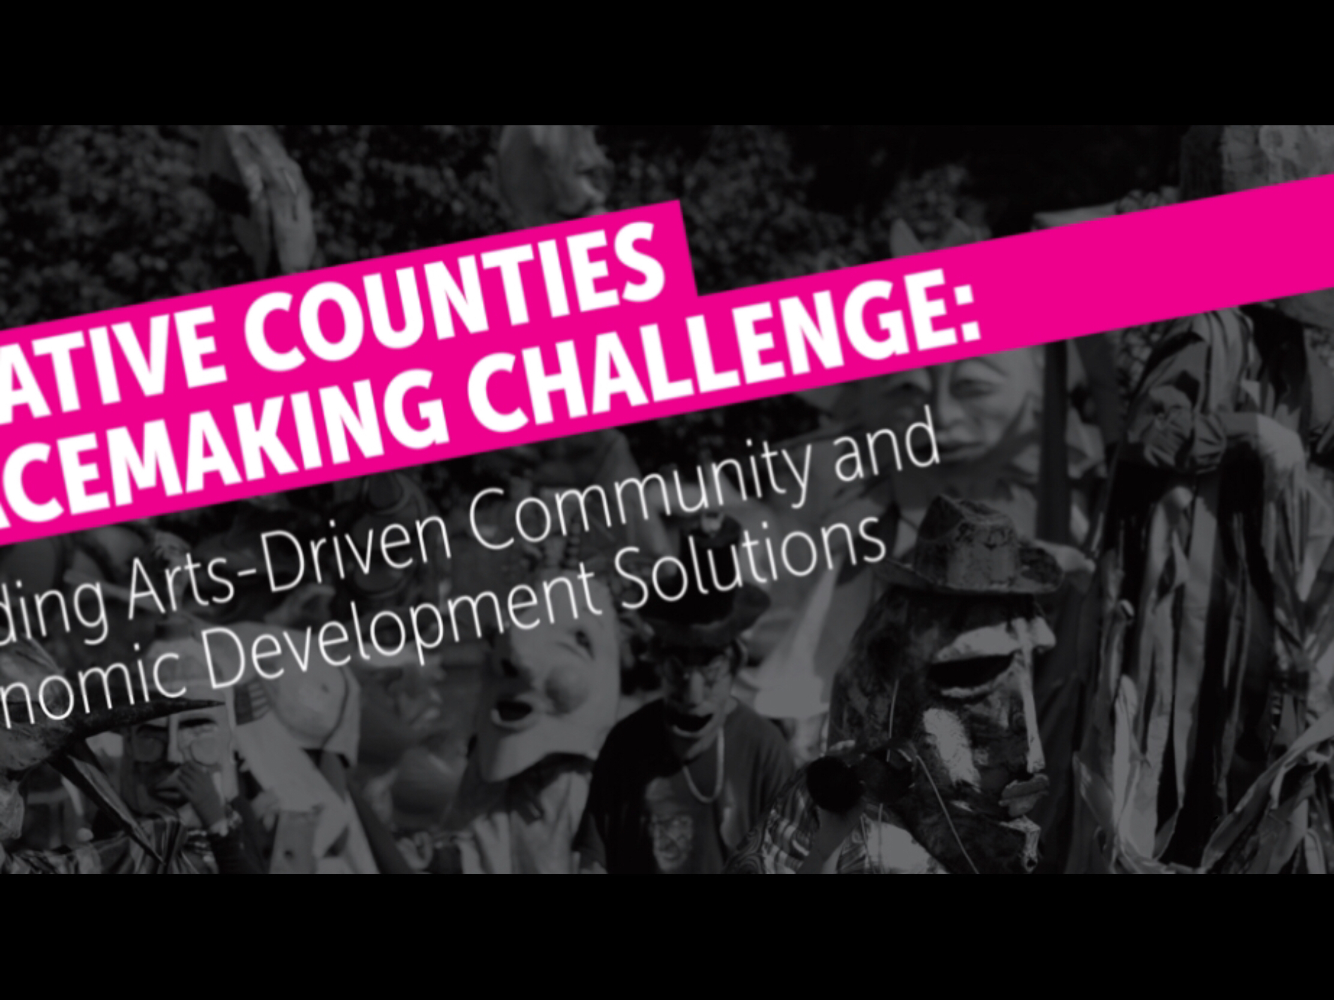

Slide 10
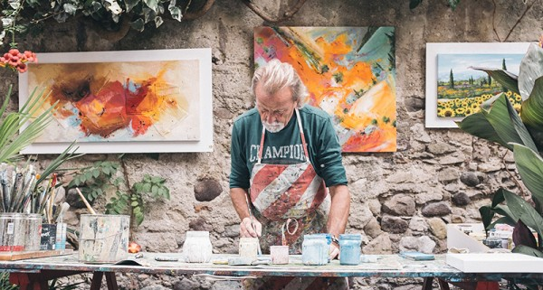

Slide 11
The Ottumwa Opportunity

Slide 12
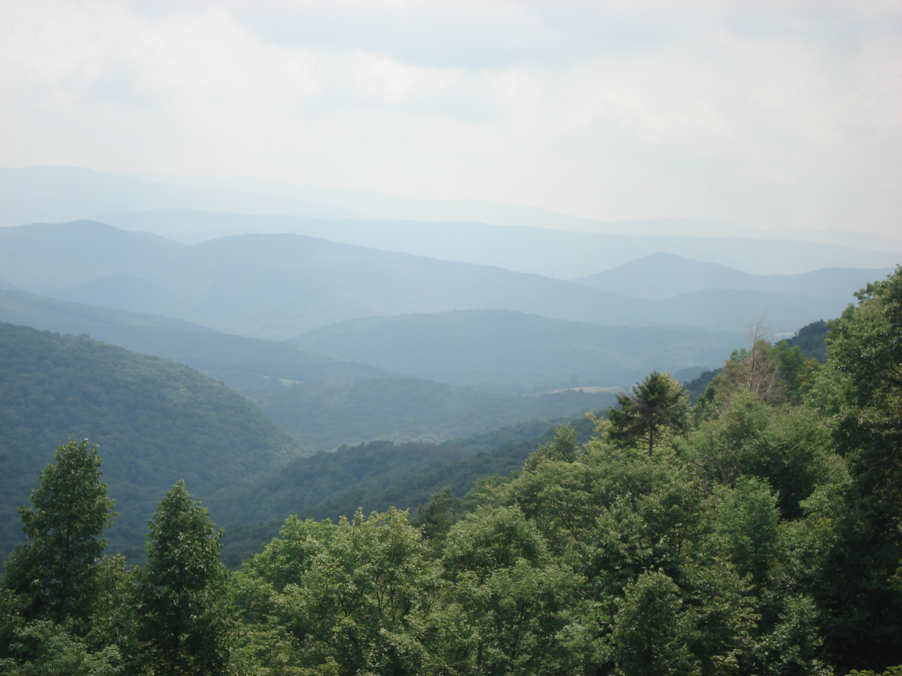


Slide 13
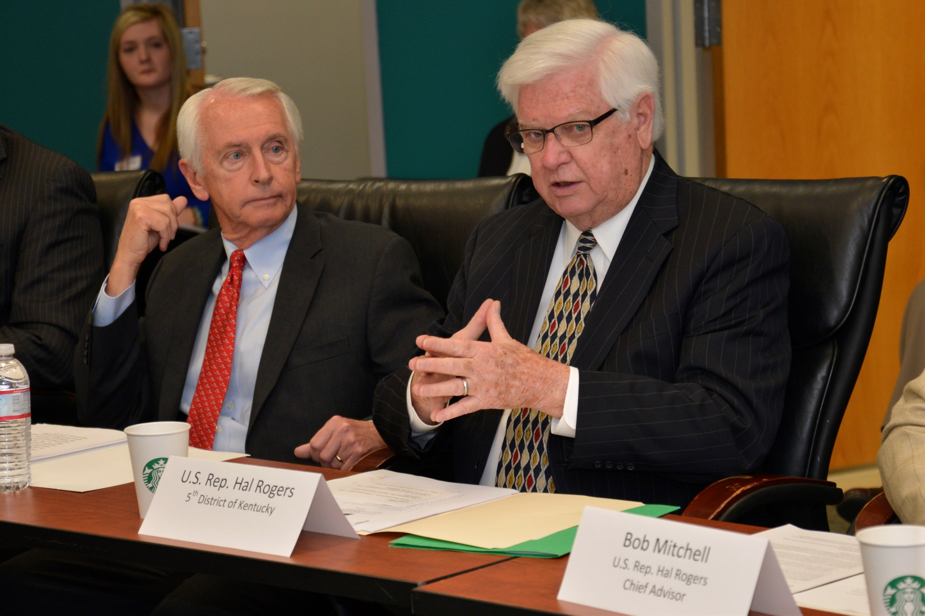

Slide 14
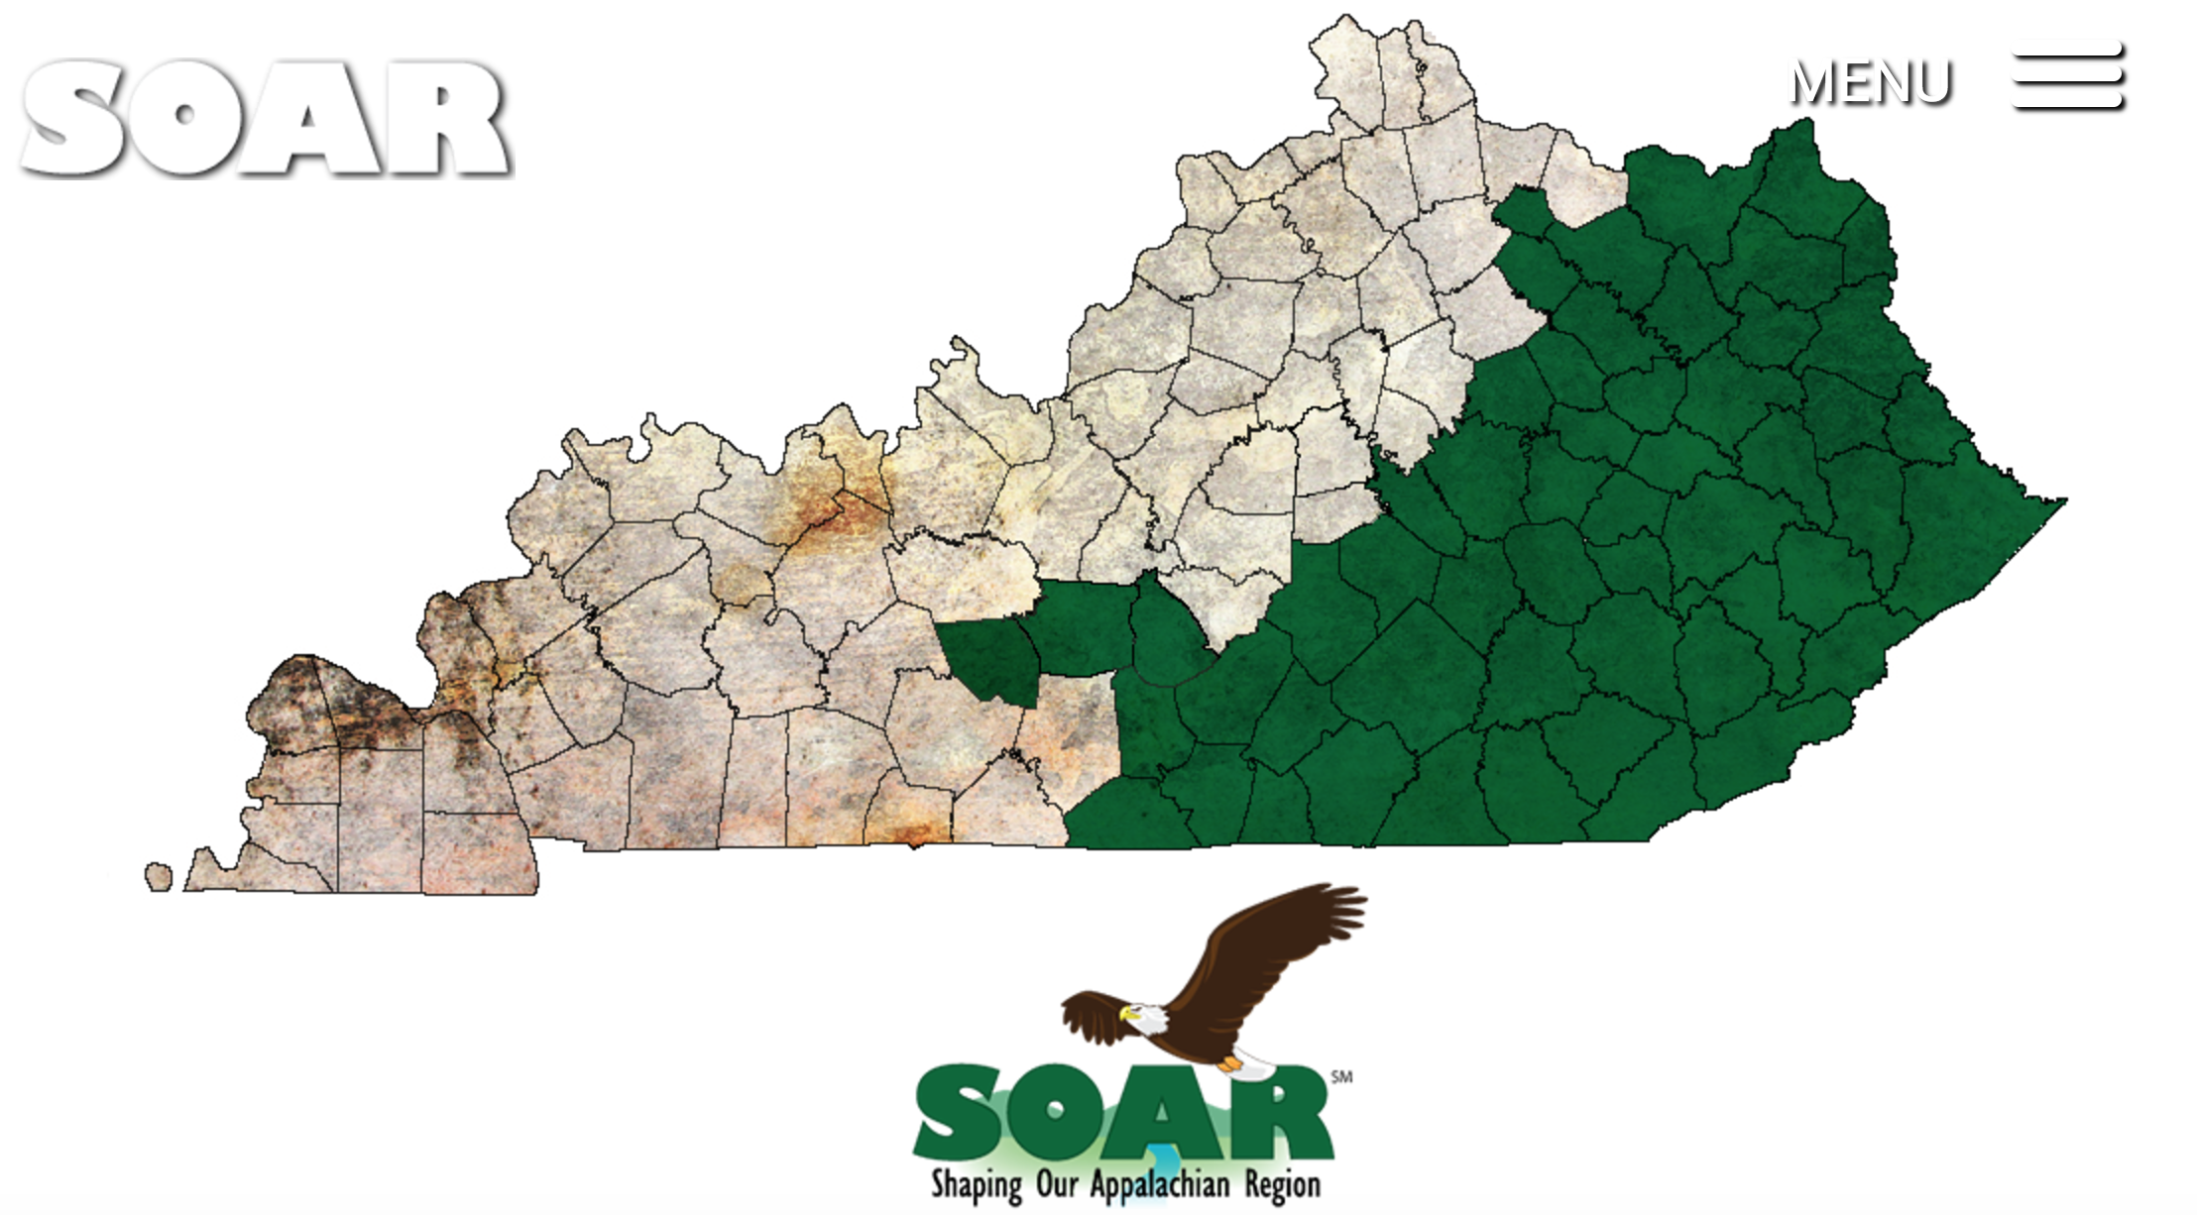

Slide 15


Slide 16




Slide 17


